Slide 1
WOODLAND SCHOOL DISTRICT
SCHOOL BOARD PRESENTATION DECEMBER 19, 2011

Slide 2
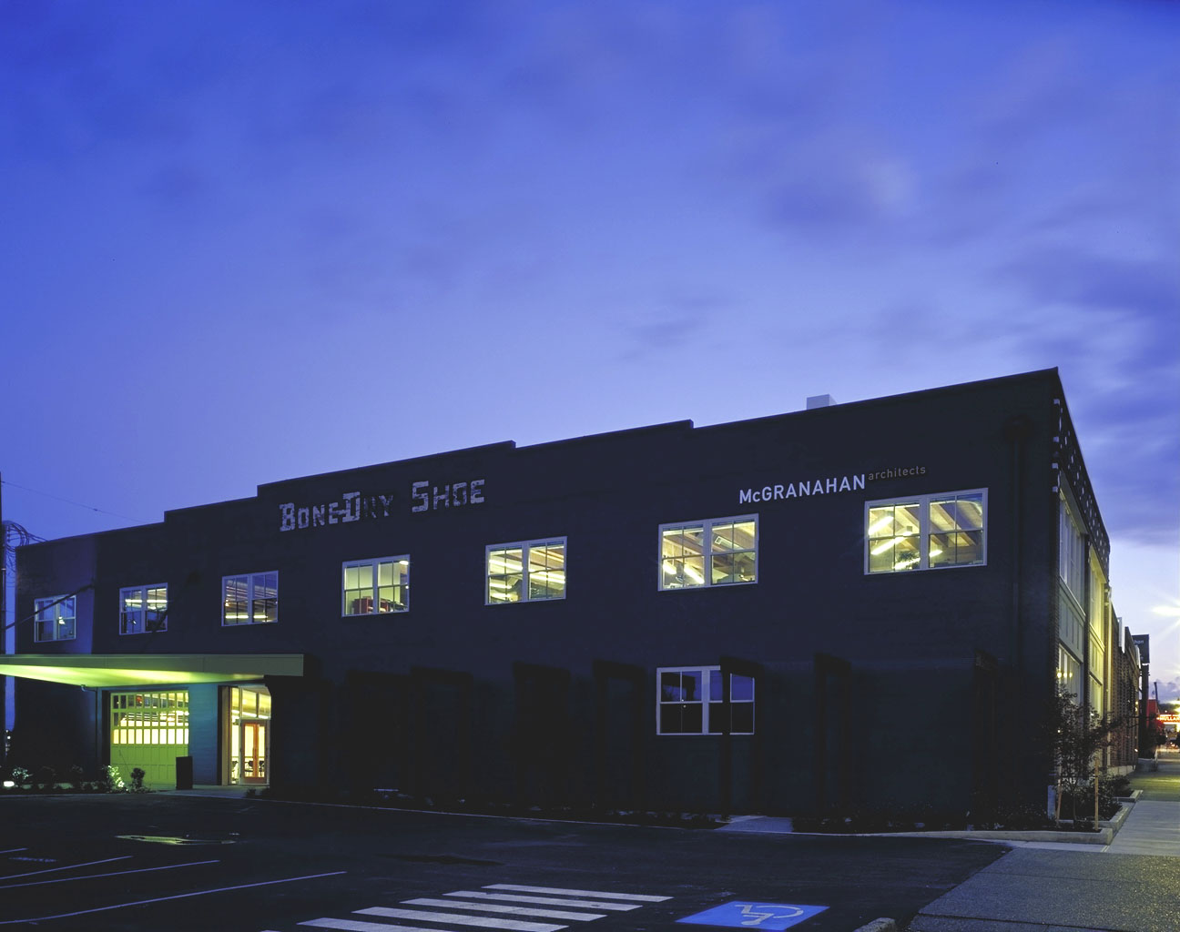
FIRM BACKGROUND
Tacoma, over 43 years in business
Top 20 firms in Western Washington
Over 300 K-12 school projects
50 school districts
Experienced with complex, phased projects
Nationally recognized school designs
90% of our projects are educational facilities
80% are for repeat clients

Slide 3
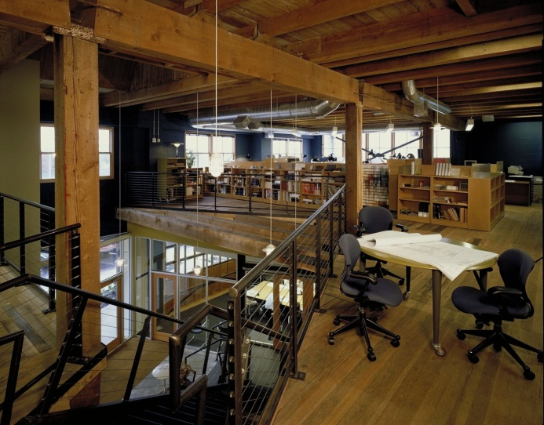
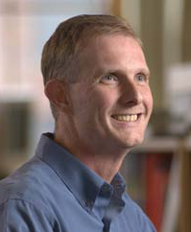
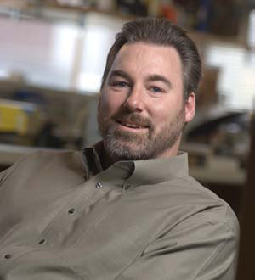
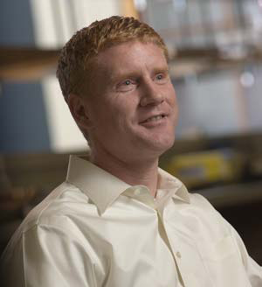
TEAM MEMBERS
Christopher J. Lilley, AIA
Principal in Charge / Project Manager
Michael F. McGavock, AIA
Programming and Pre-Design
Darrin M. Filand, AIA
Lead Designer

Slide 4
PROJECT TEAM

Slide 5
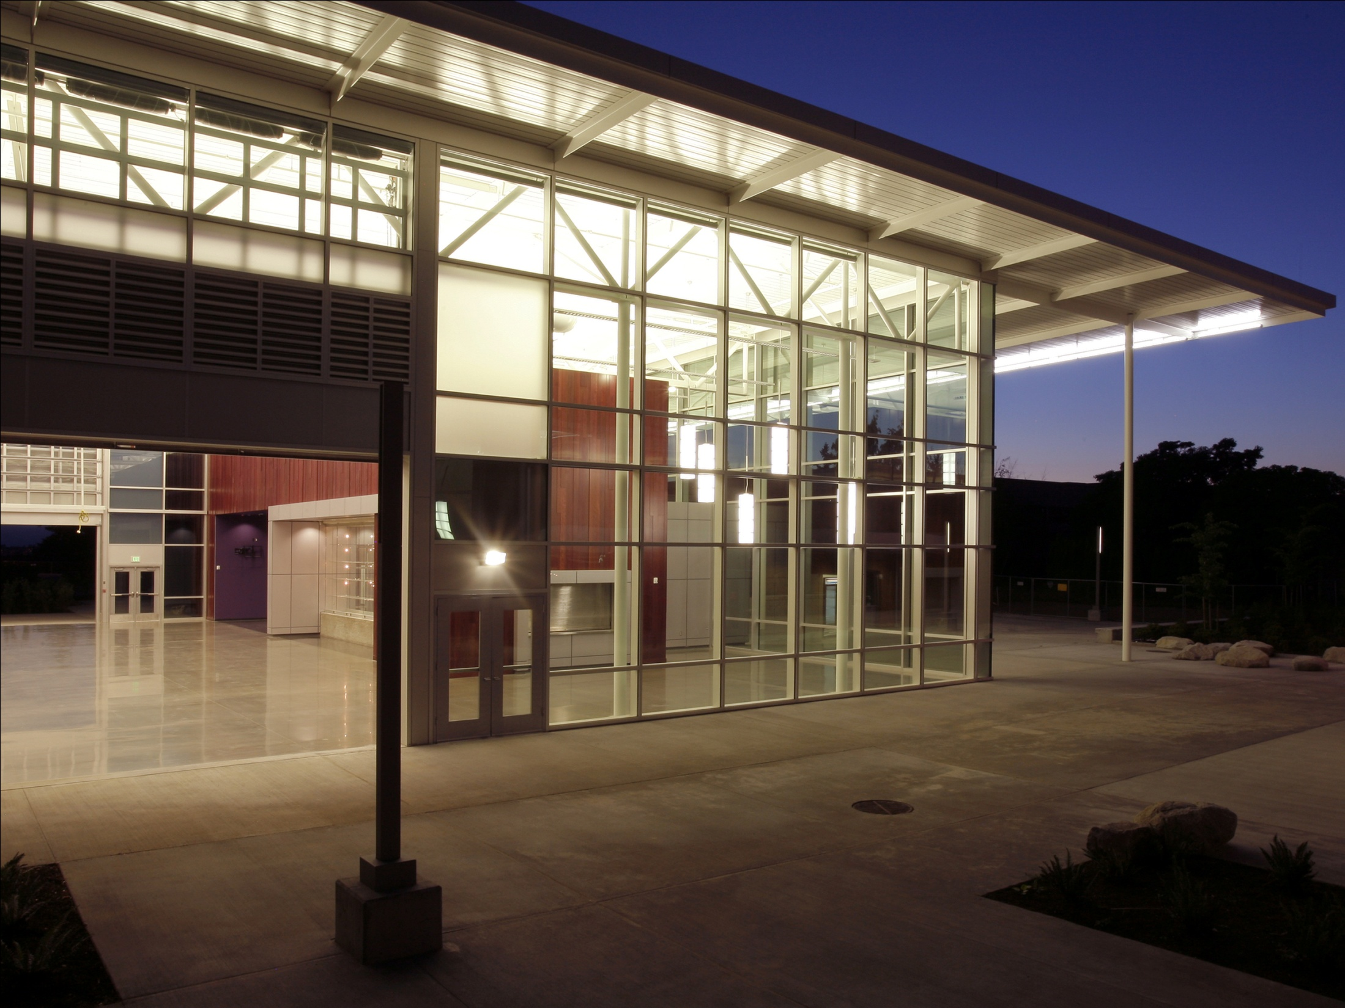
creating BALANCED AND REMARKABLE ARCHITECTURE
We are responsive to all the forces that, when properly balanced and well crafted, lead to lasting and responsible design solutions.

Slide 6
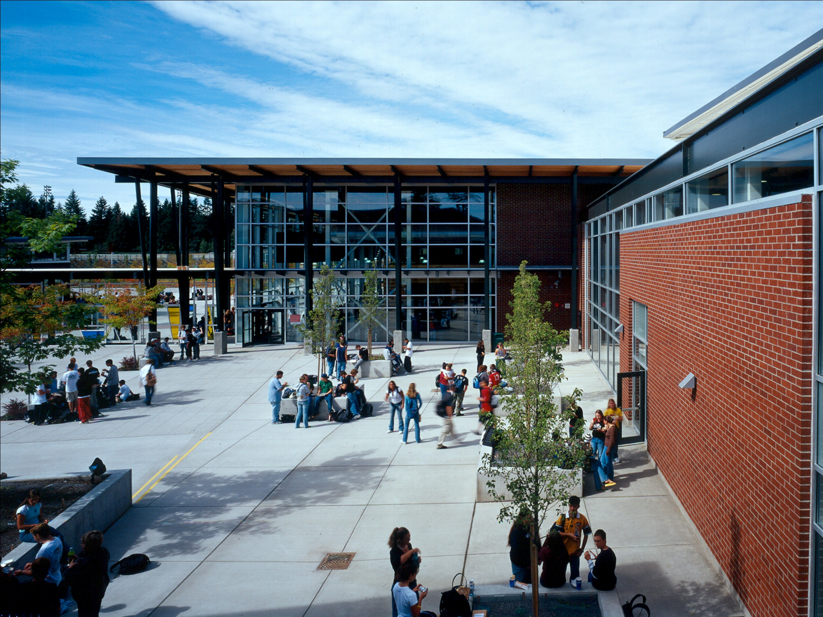

Slide 7
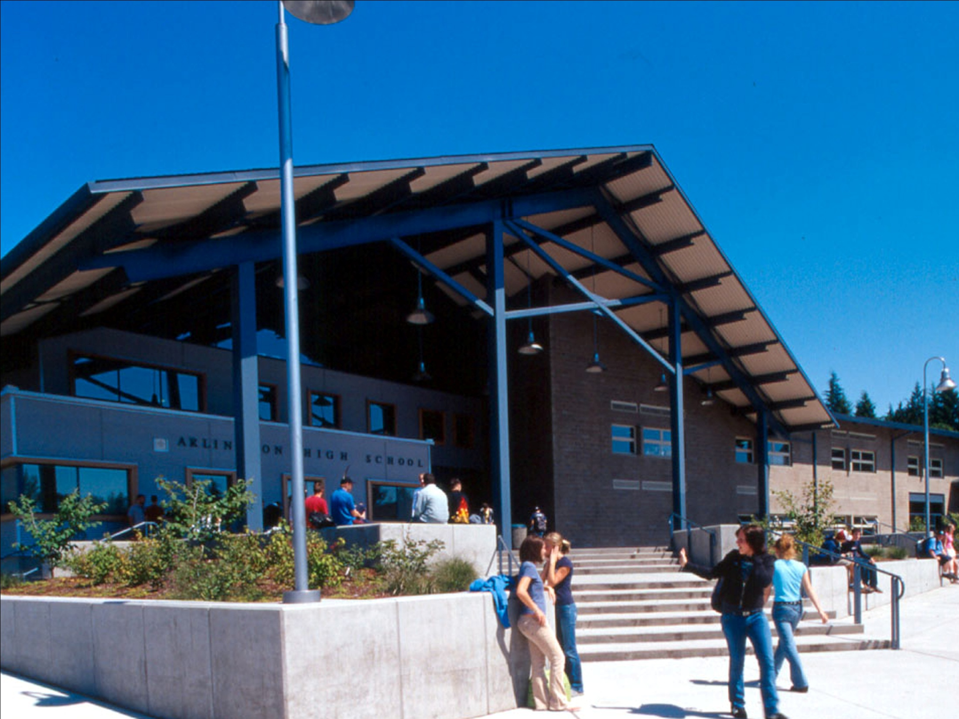

Slide 8
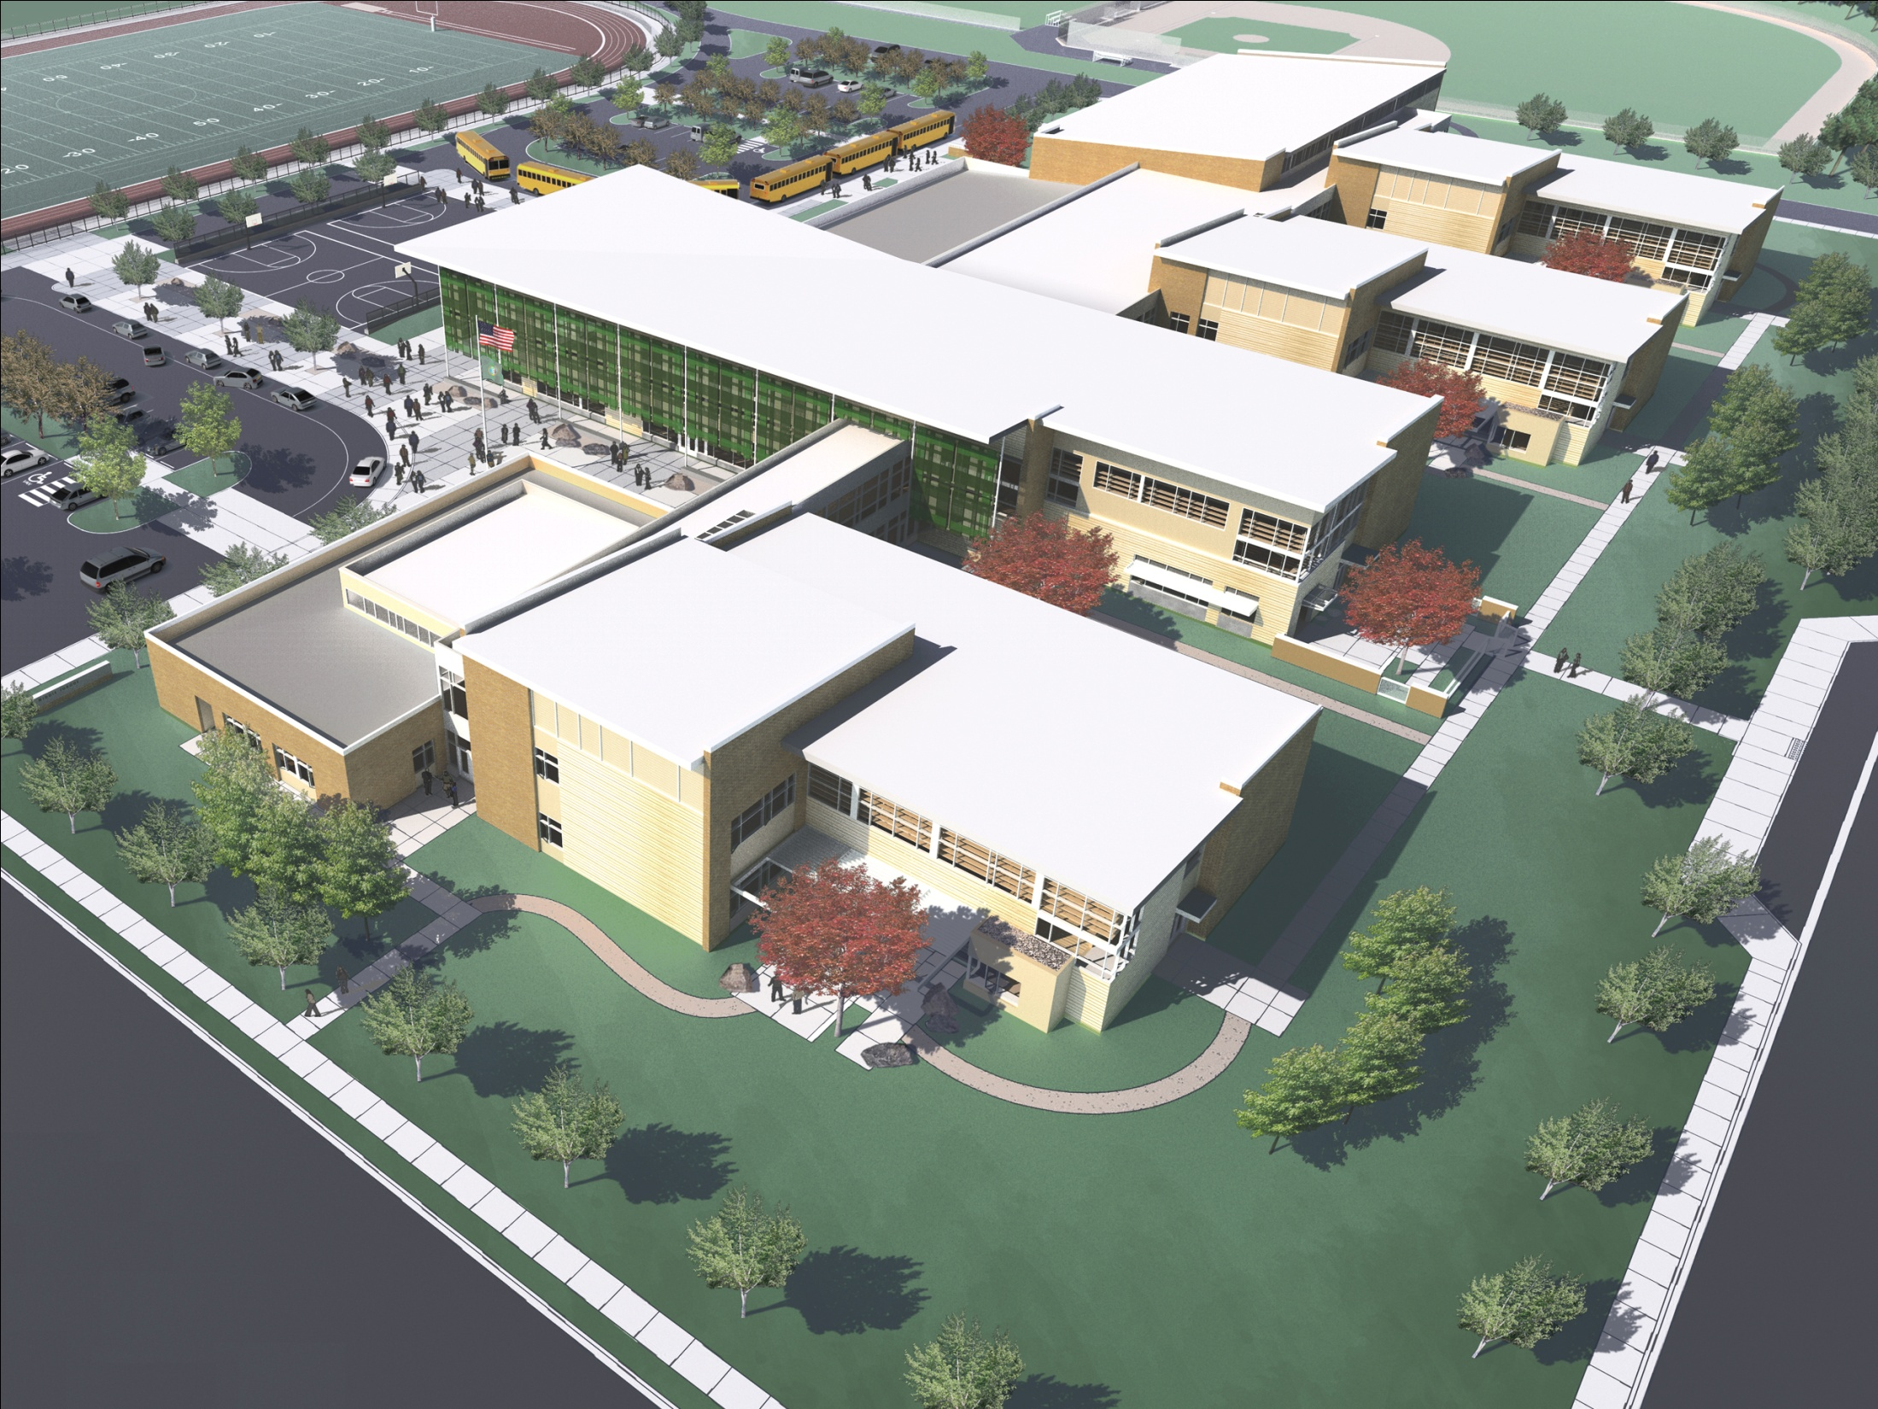

Slide 9
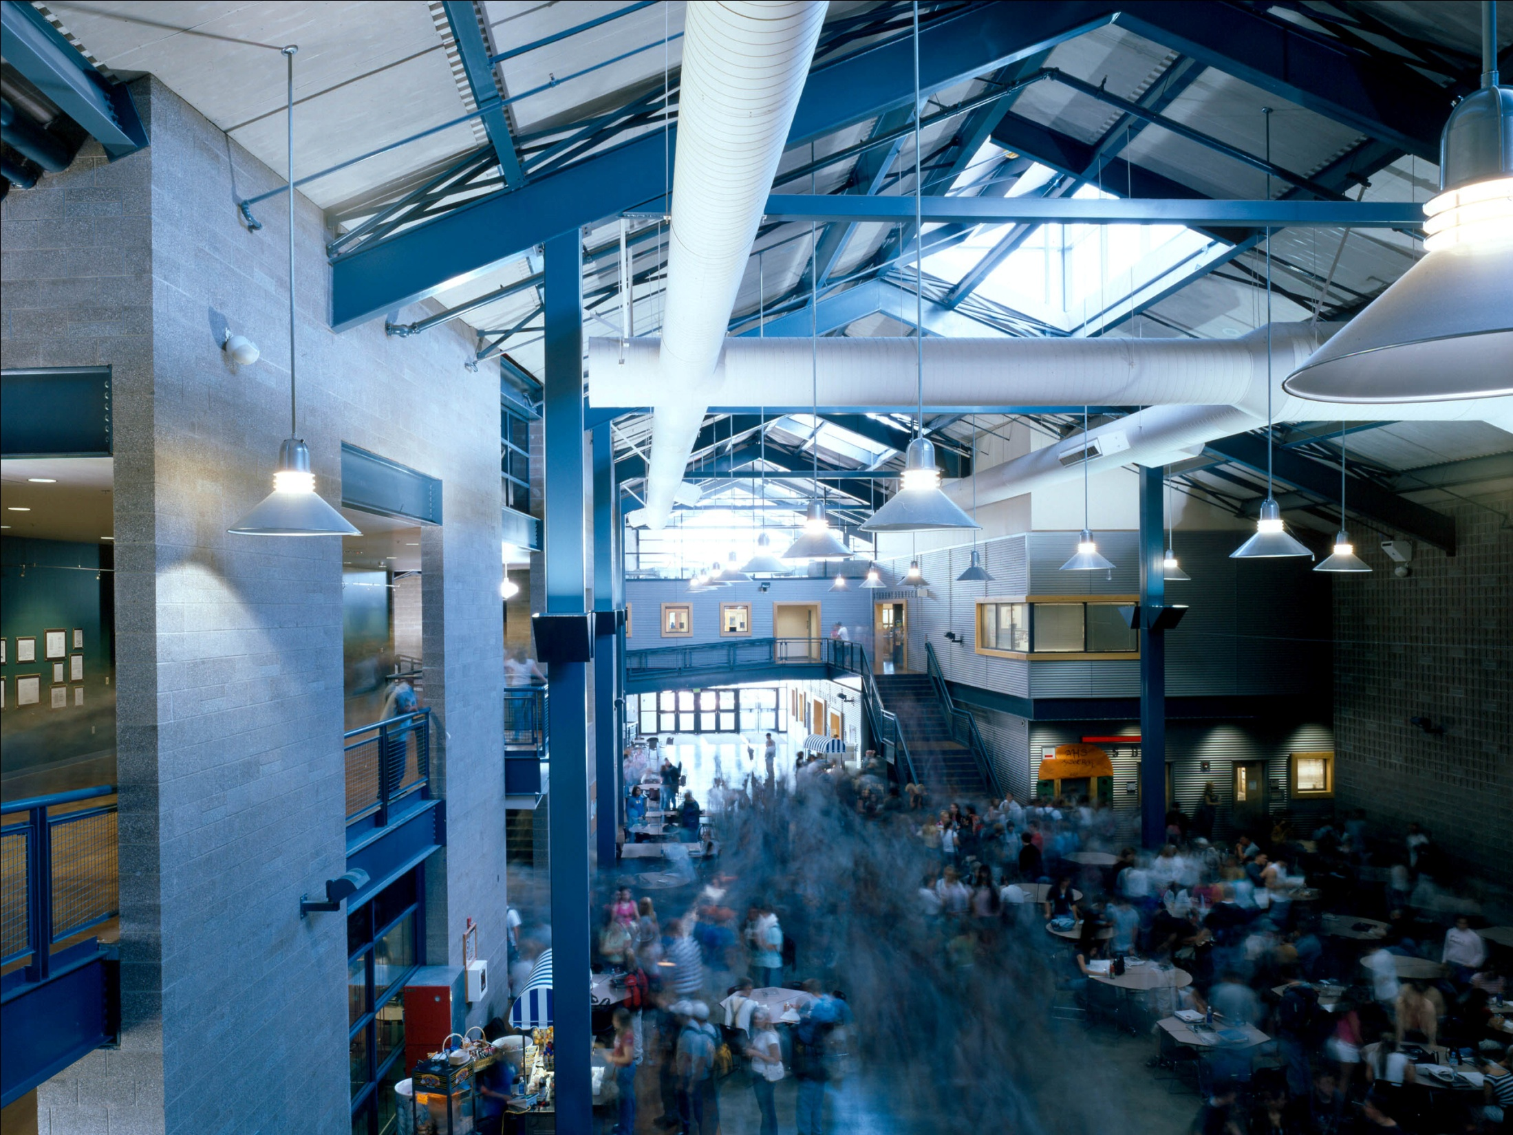

Slide 10
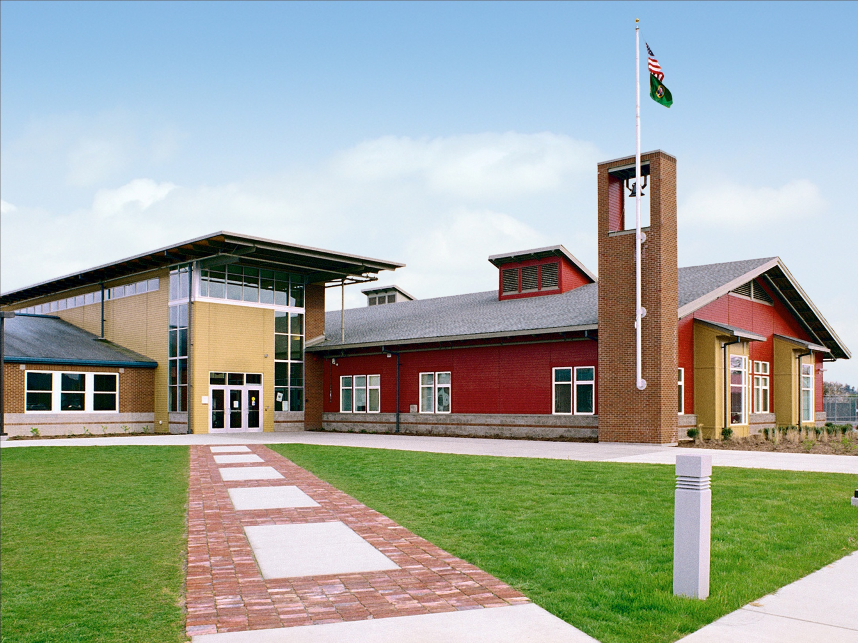

Slide 11
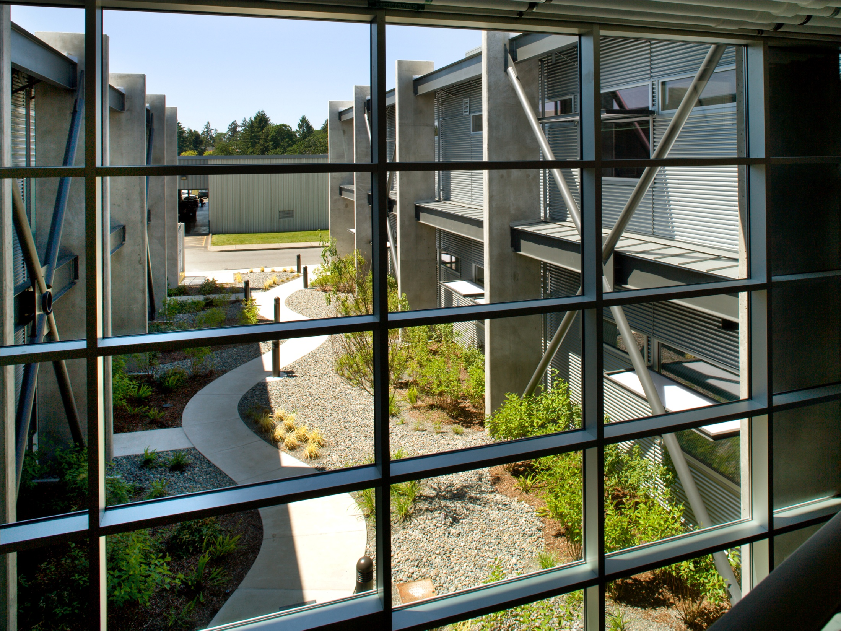

Slide 12
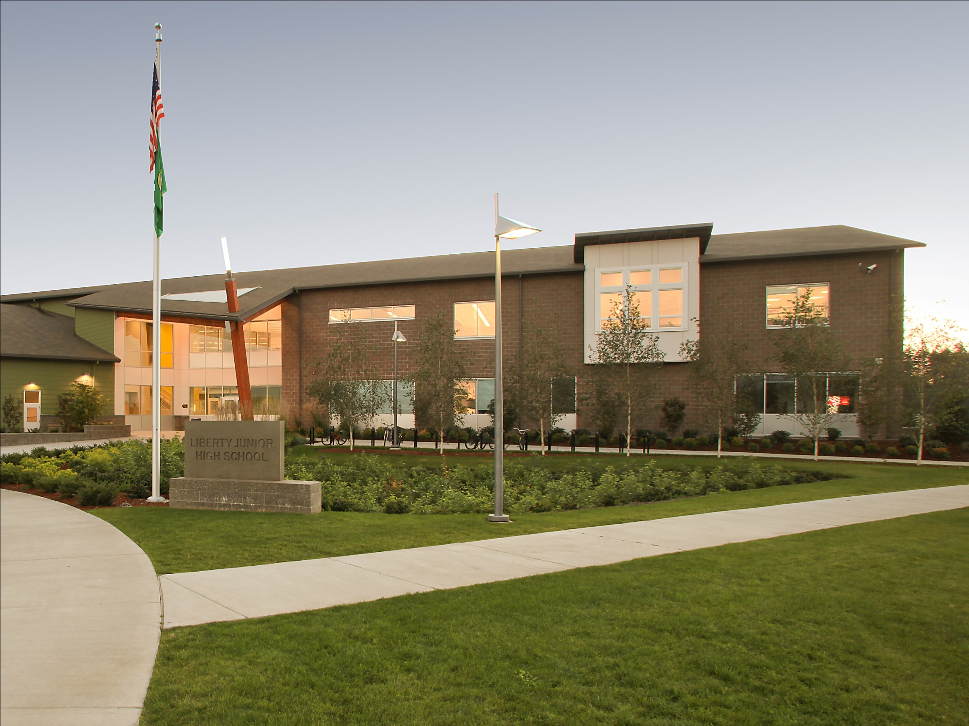

Slide 13
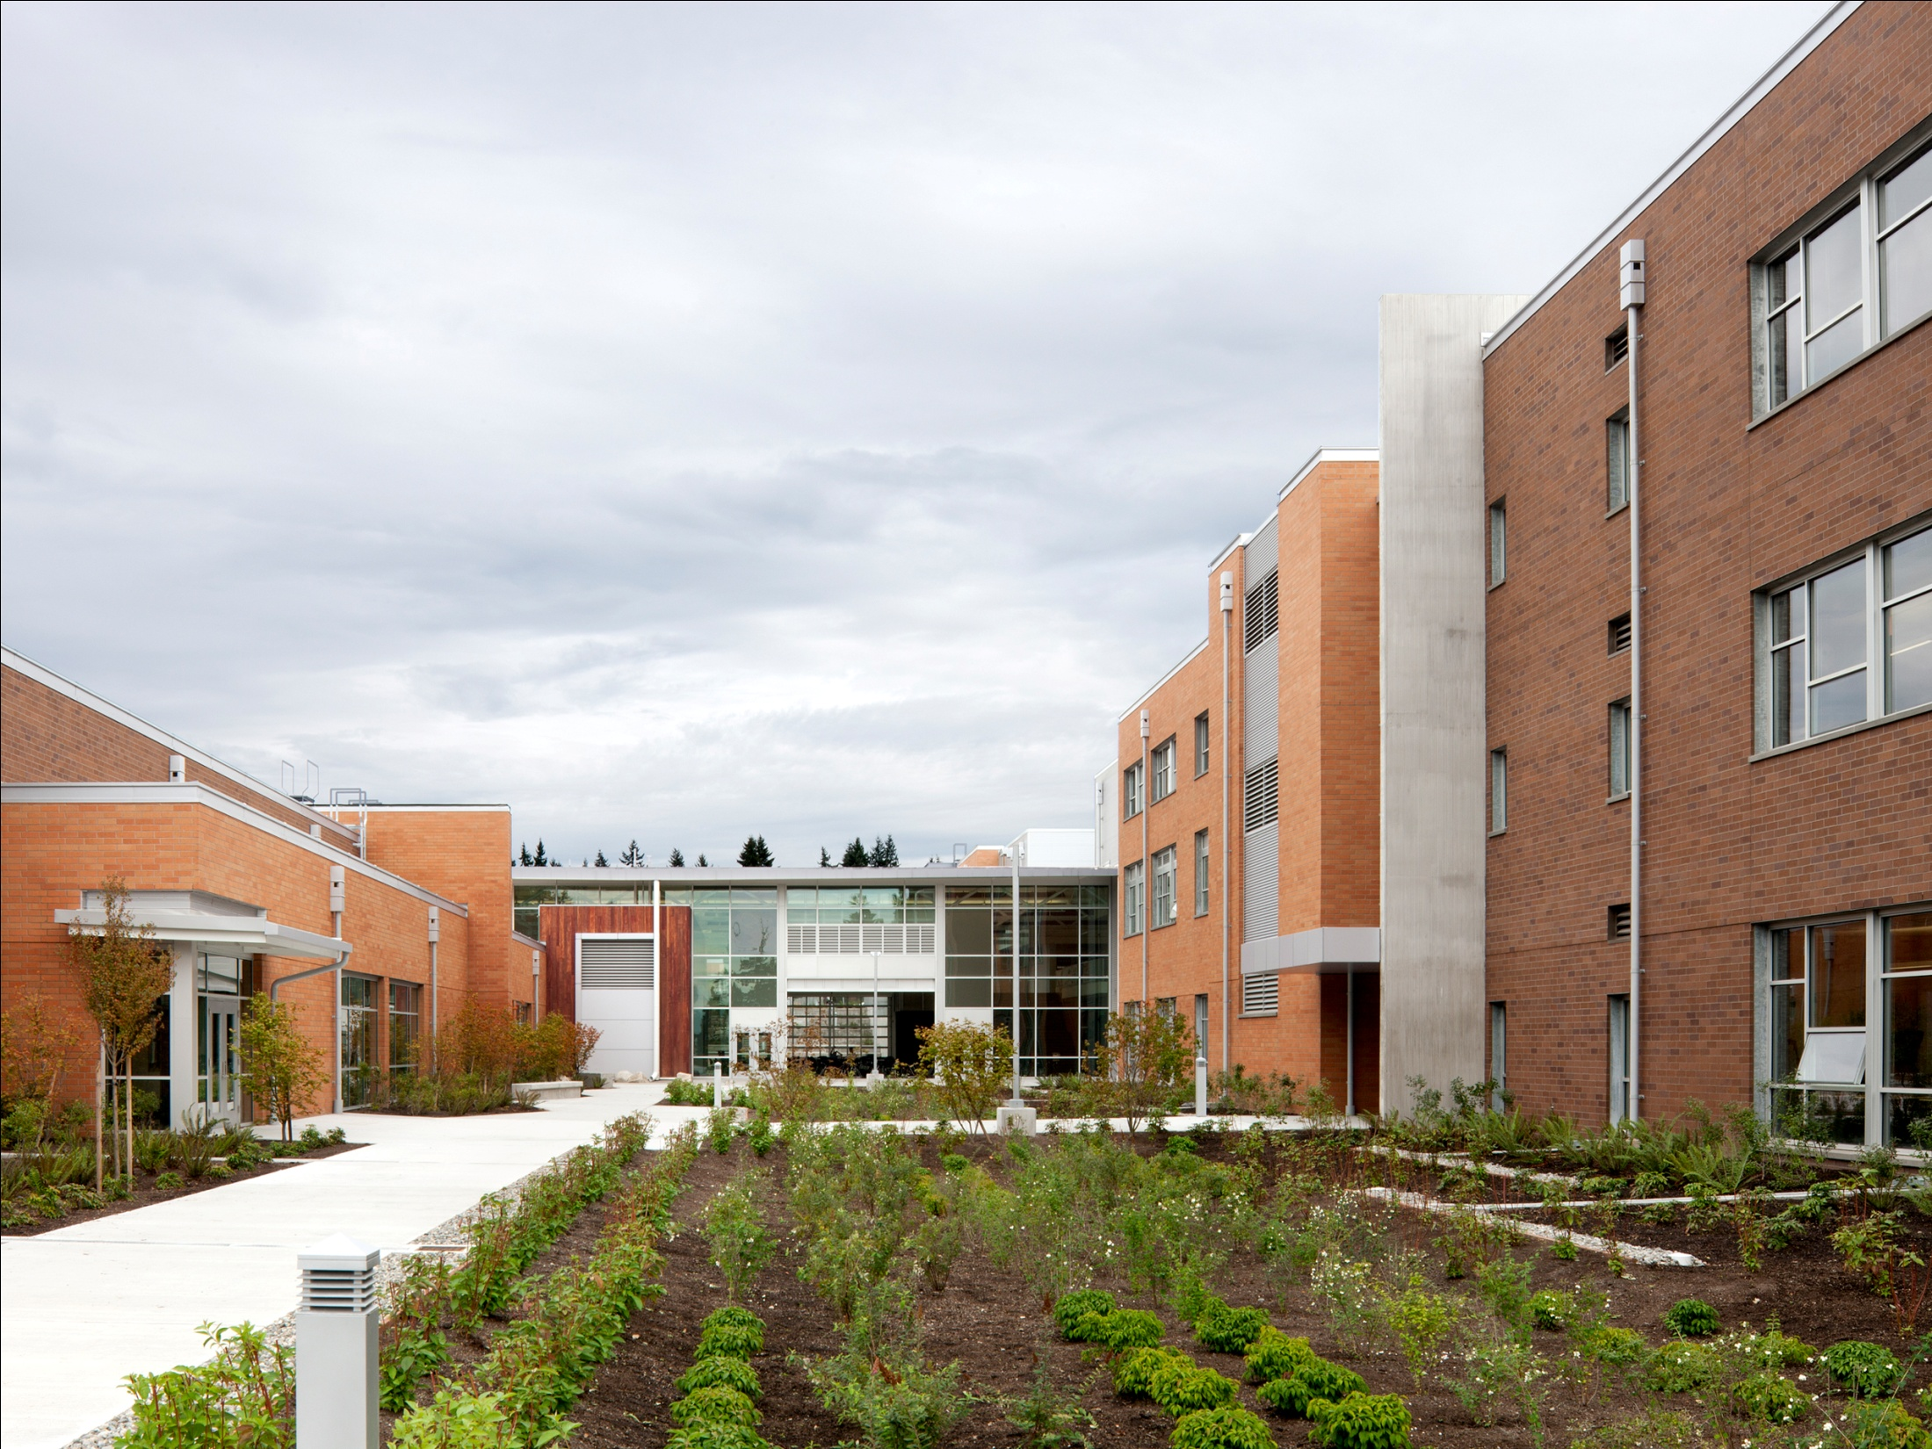

Slide 14
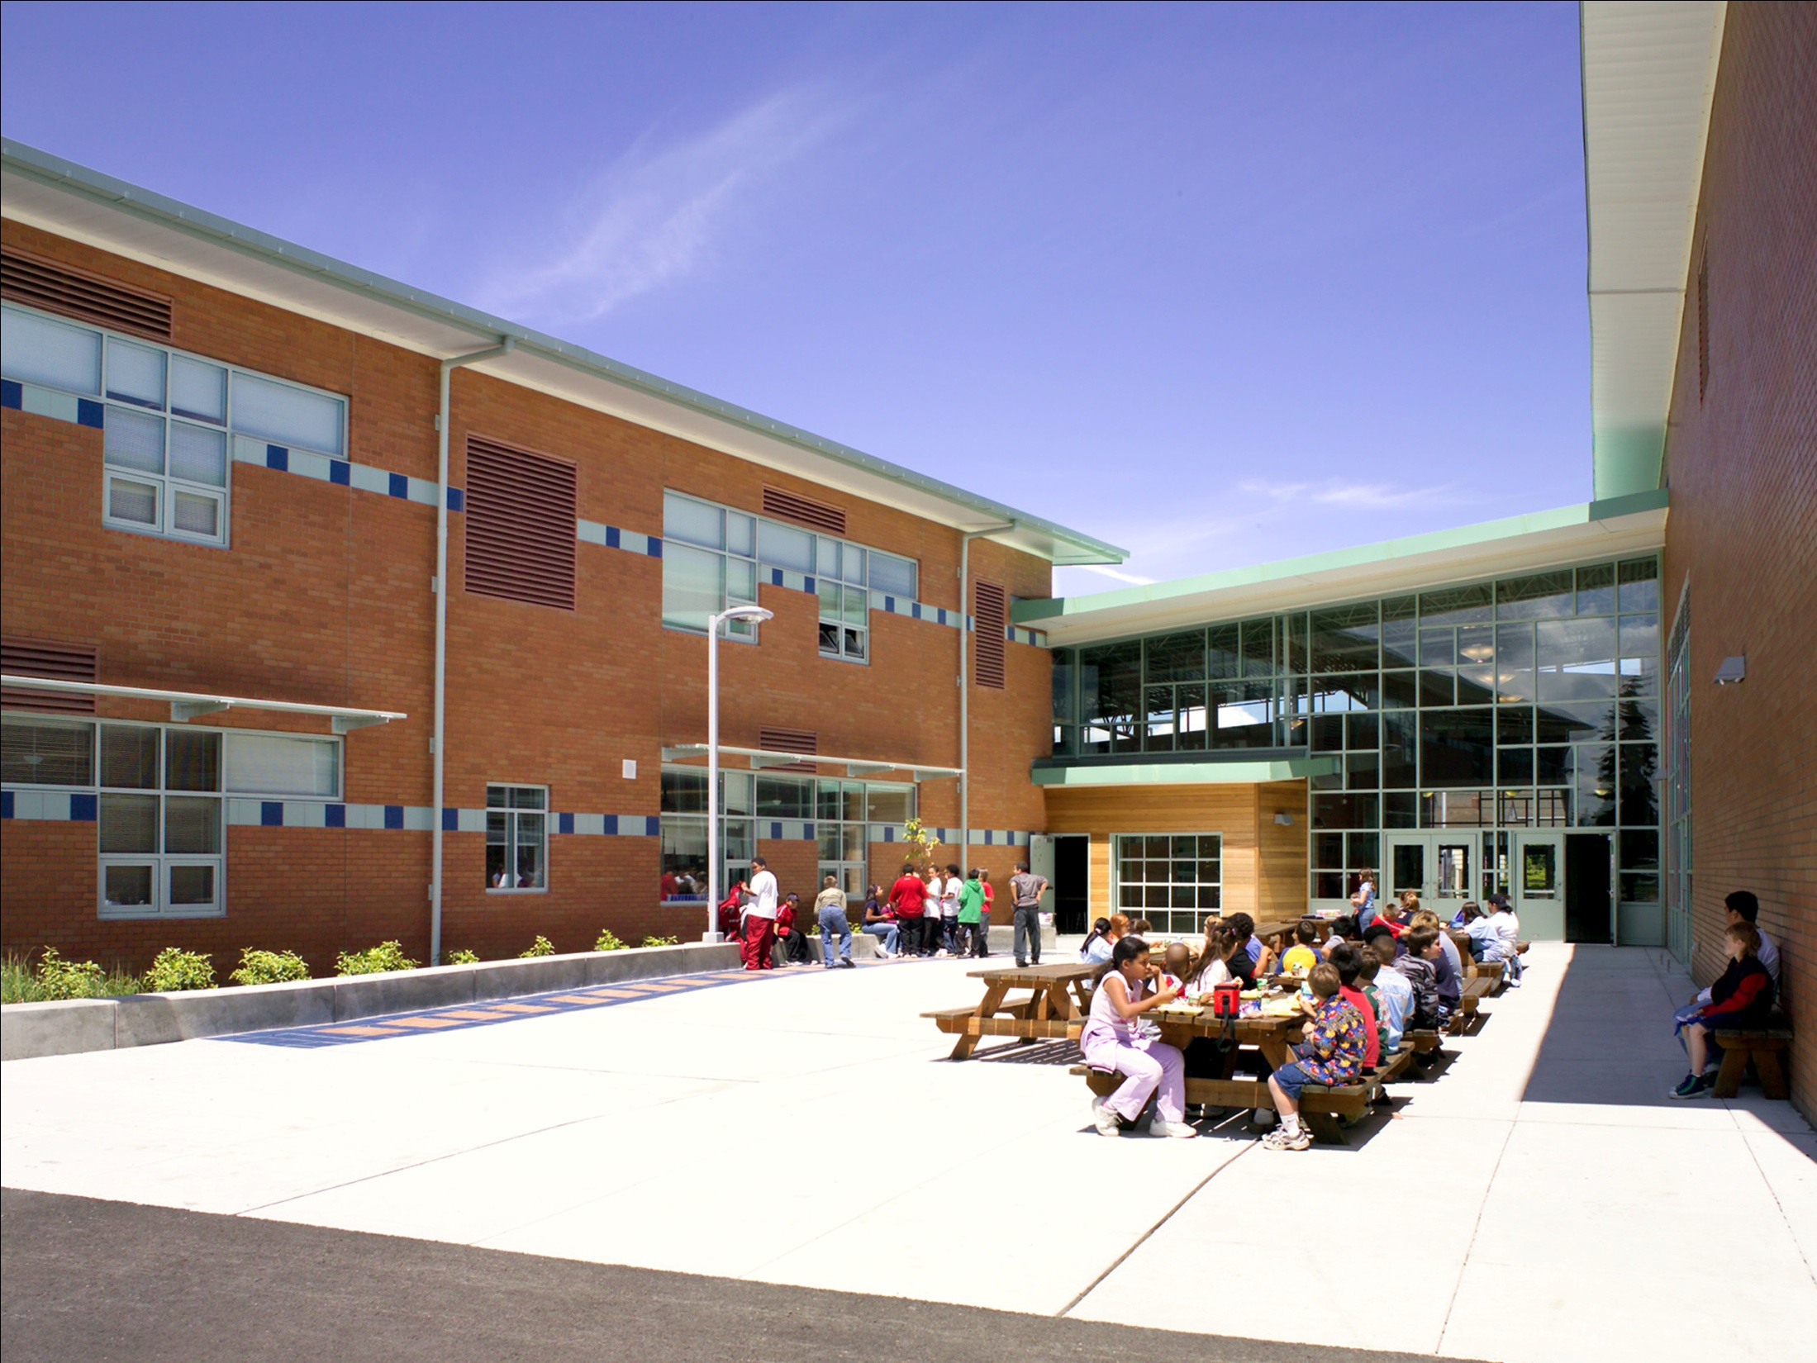

Slide 15
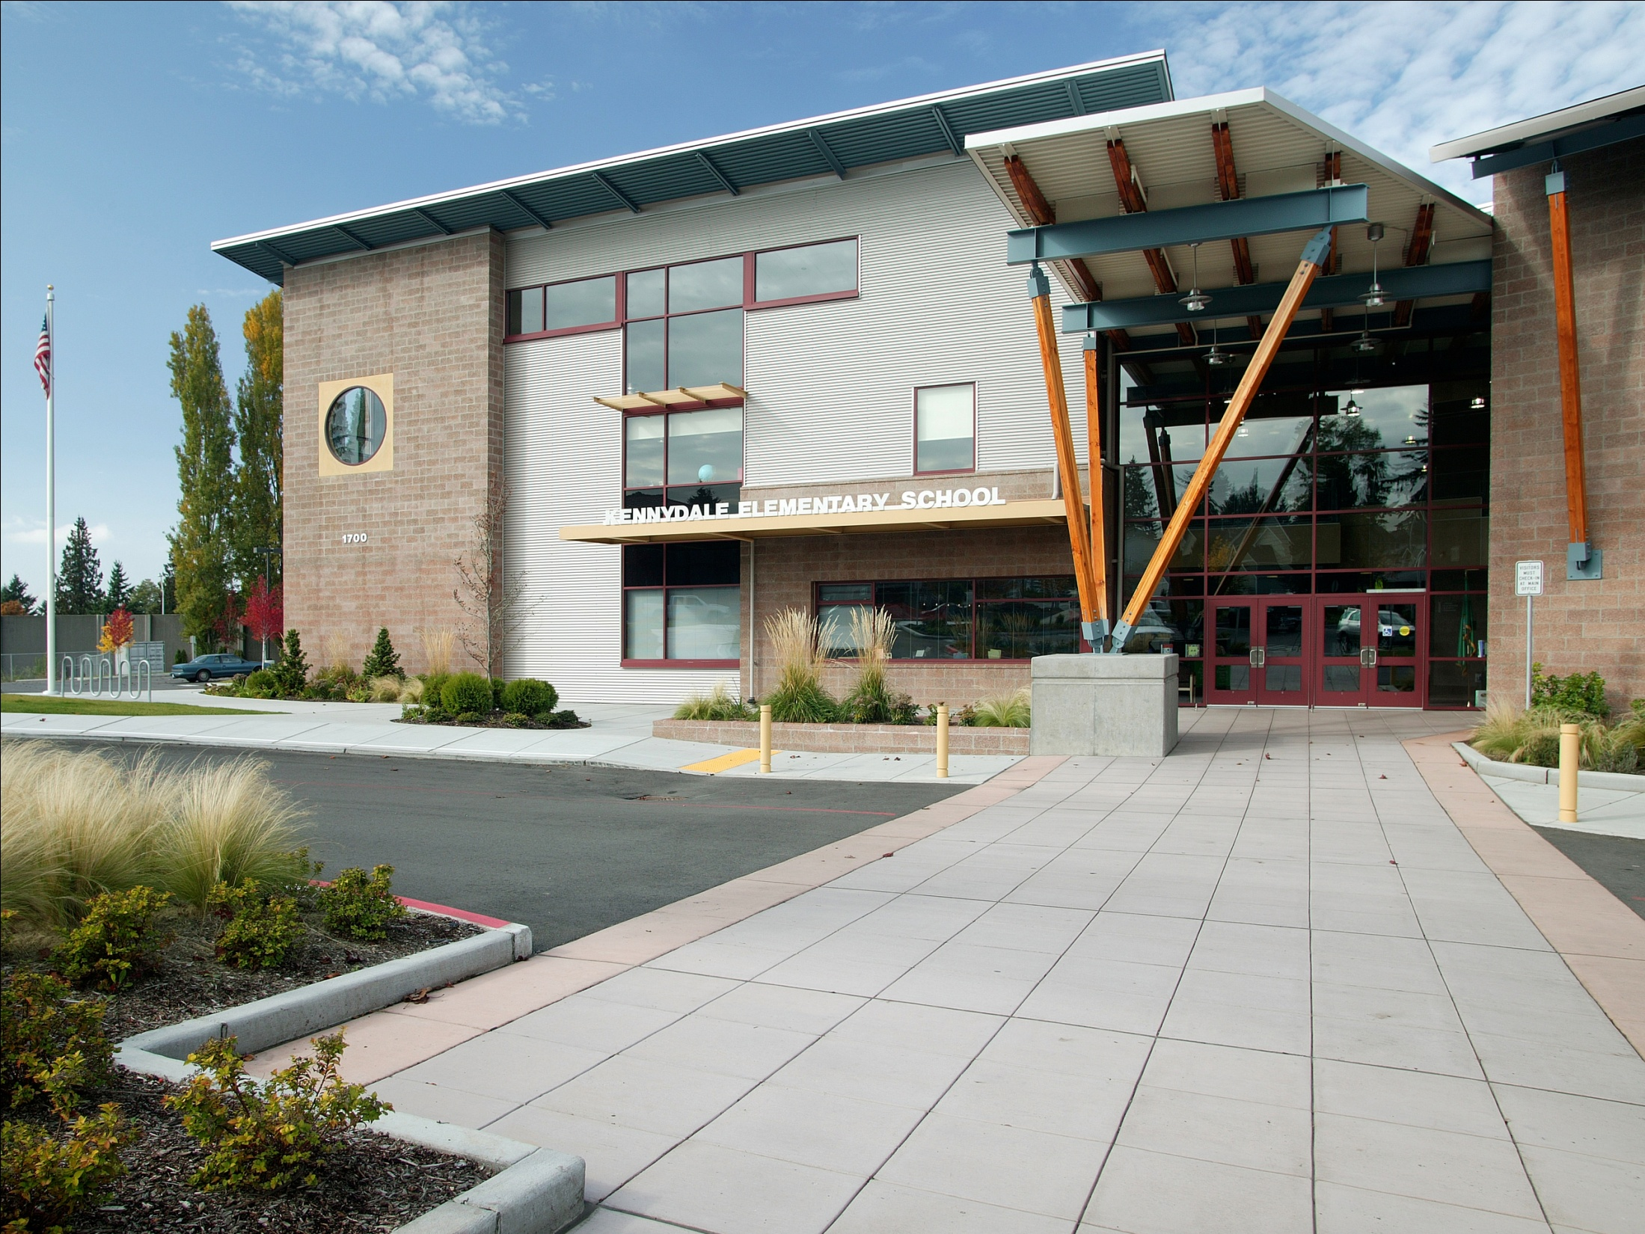

Slide 16
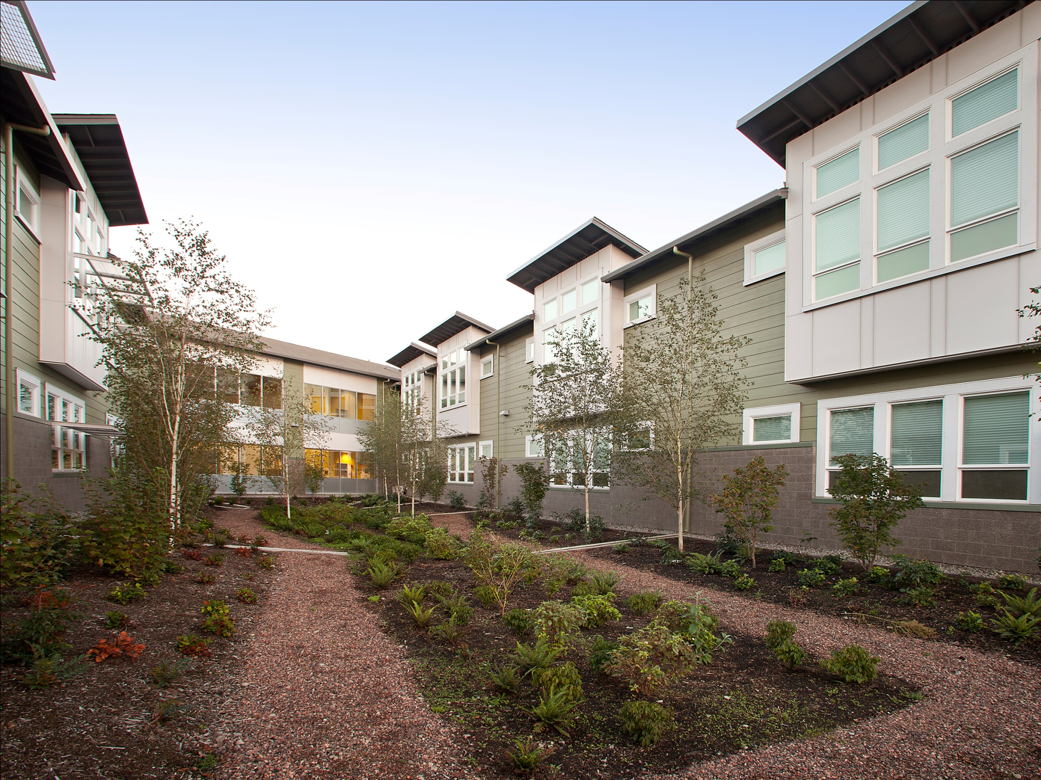

Slide 17
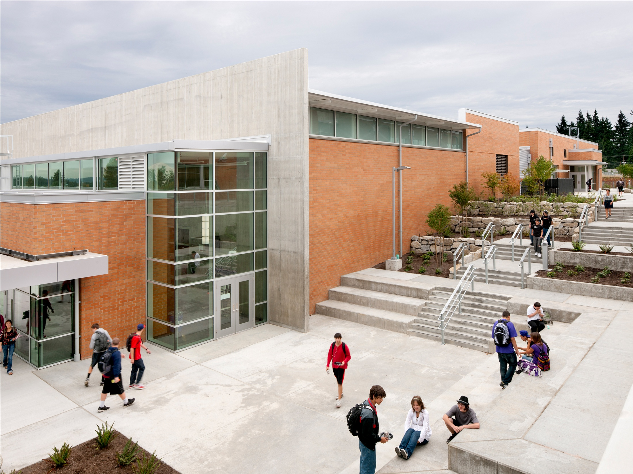

Slide 18
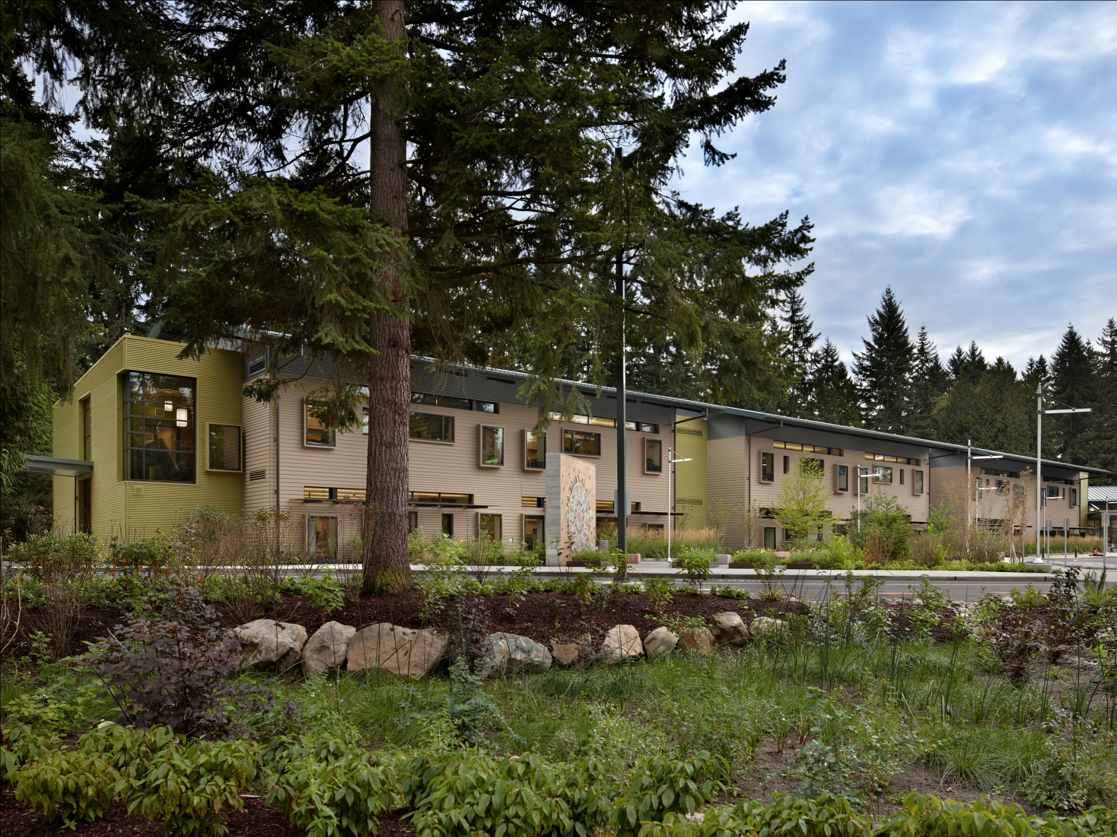

Slide 19
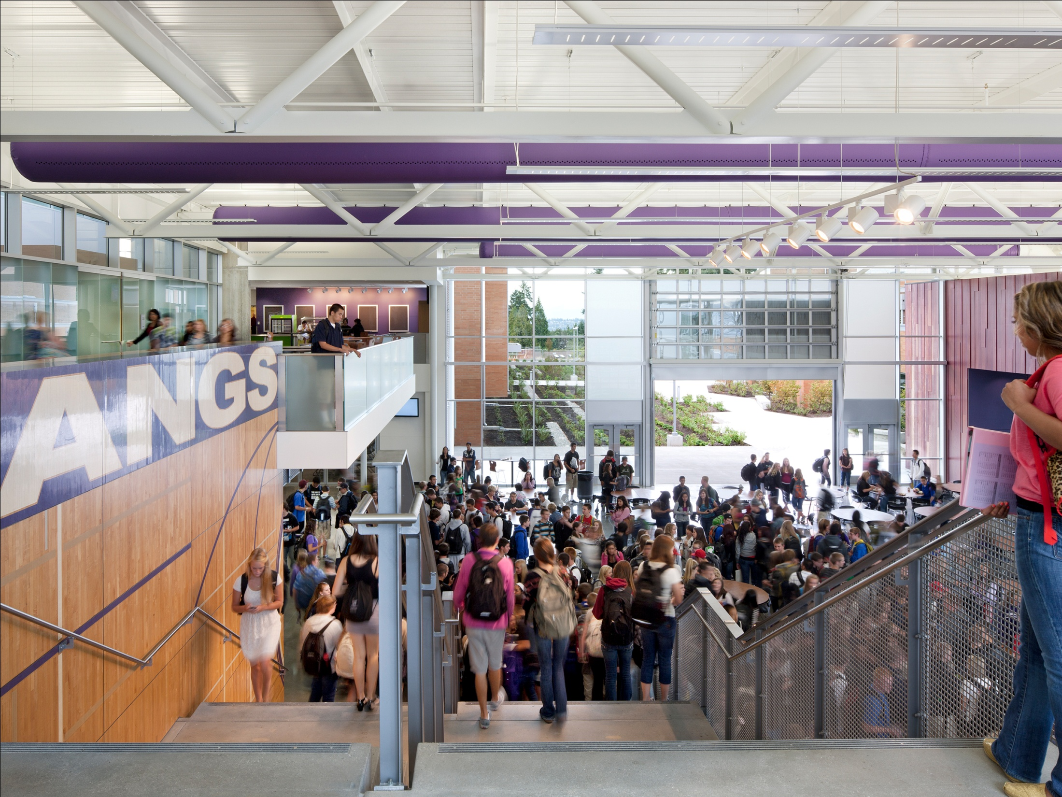

Slide 20
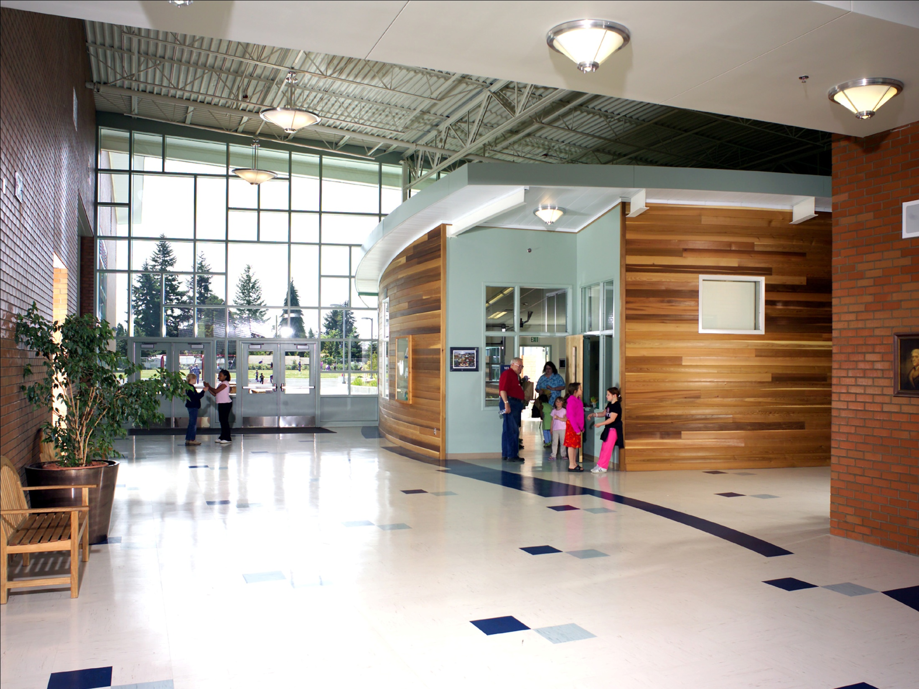

Slide 21
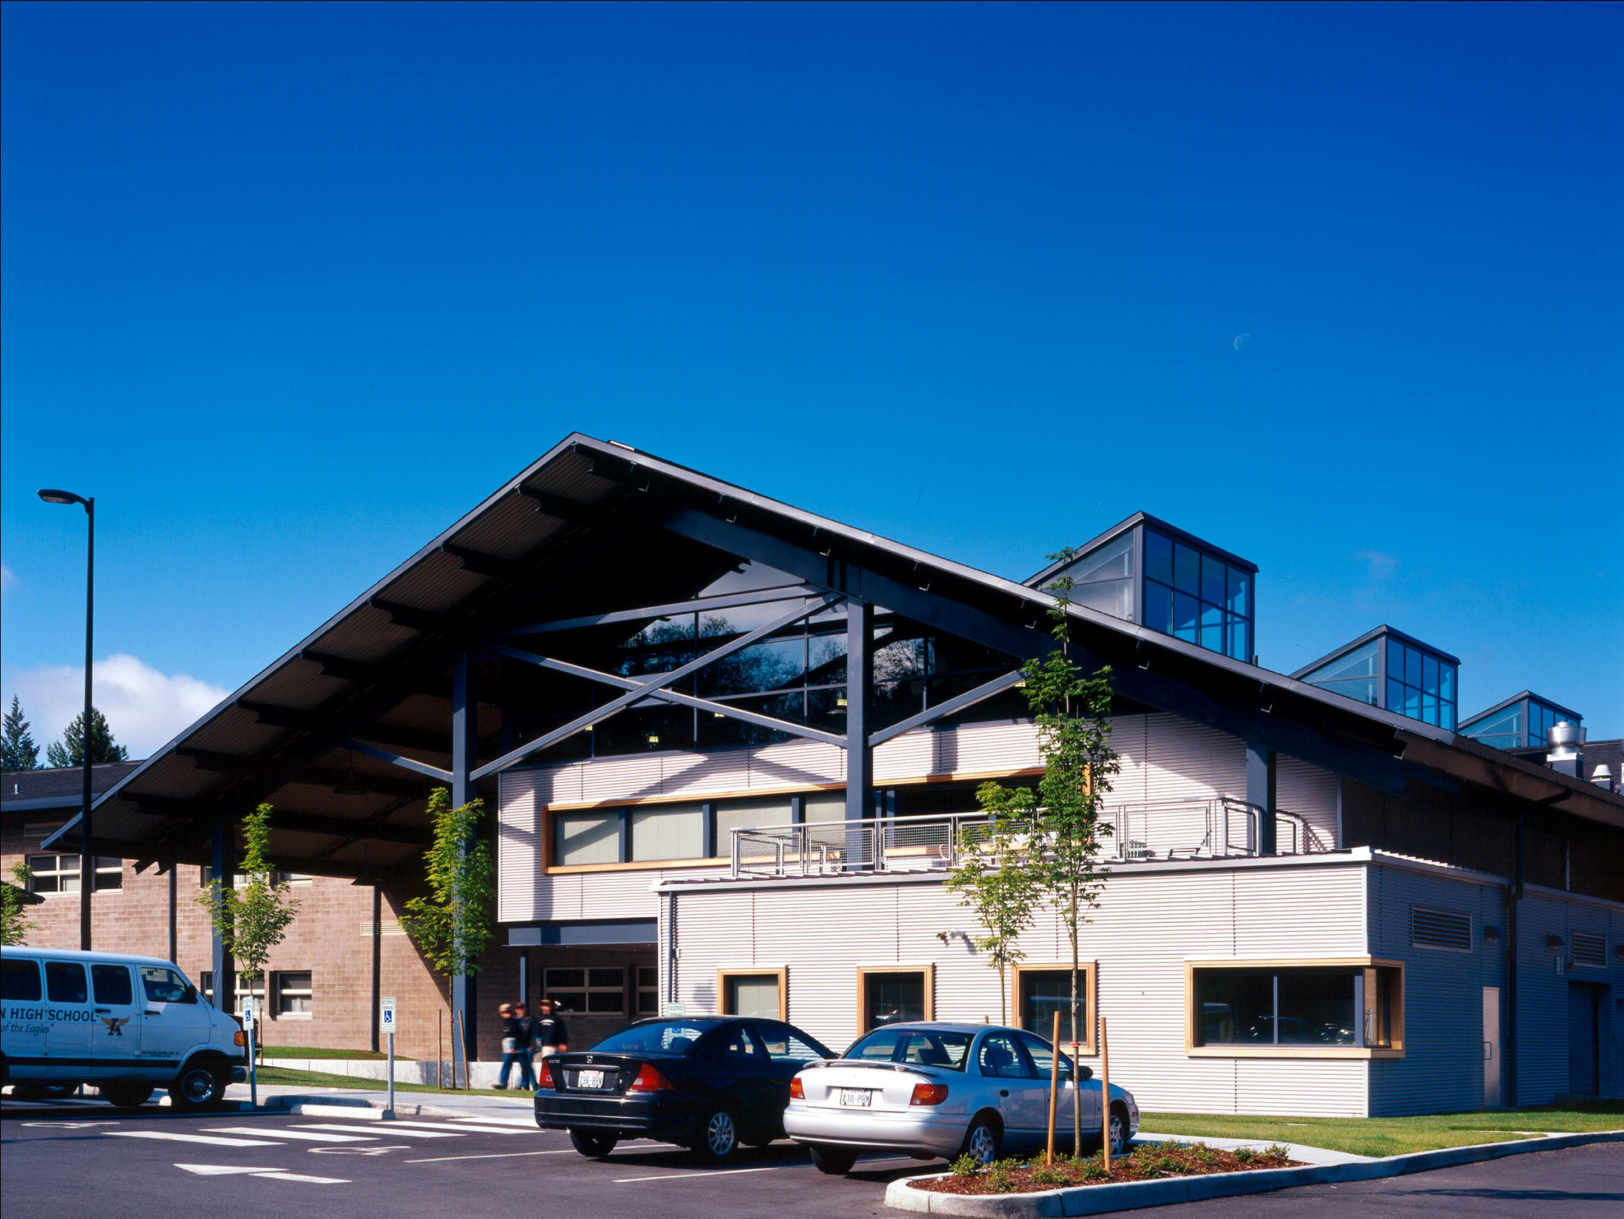

Slide 22
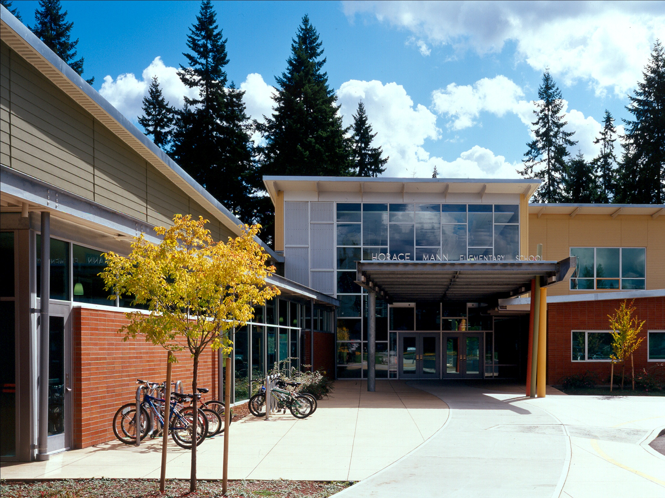

Slide 23
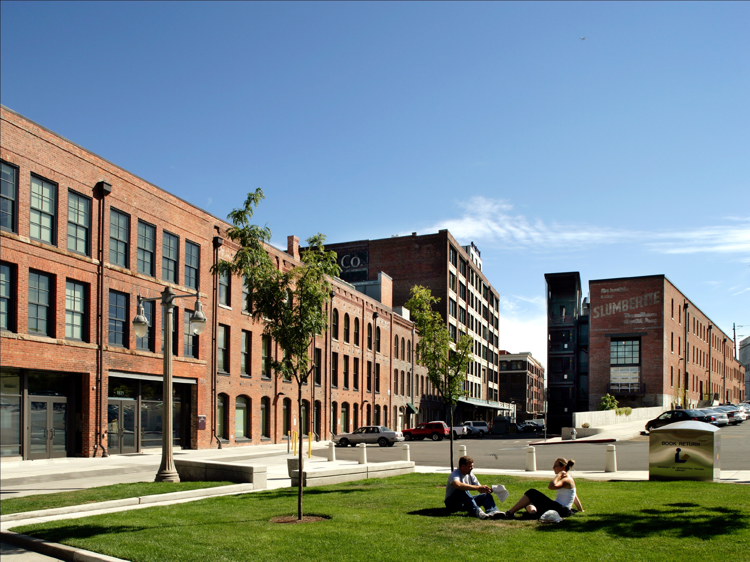

Slide 24
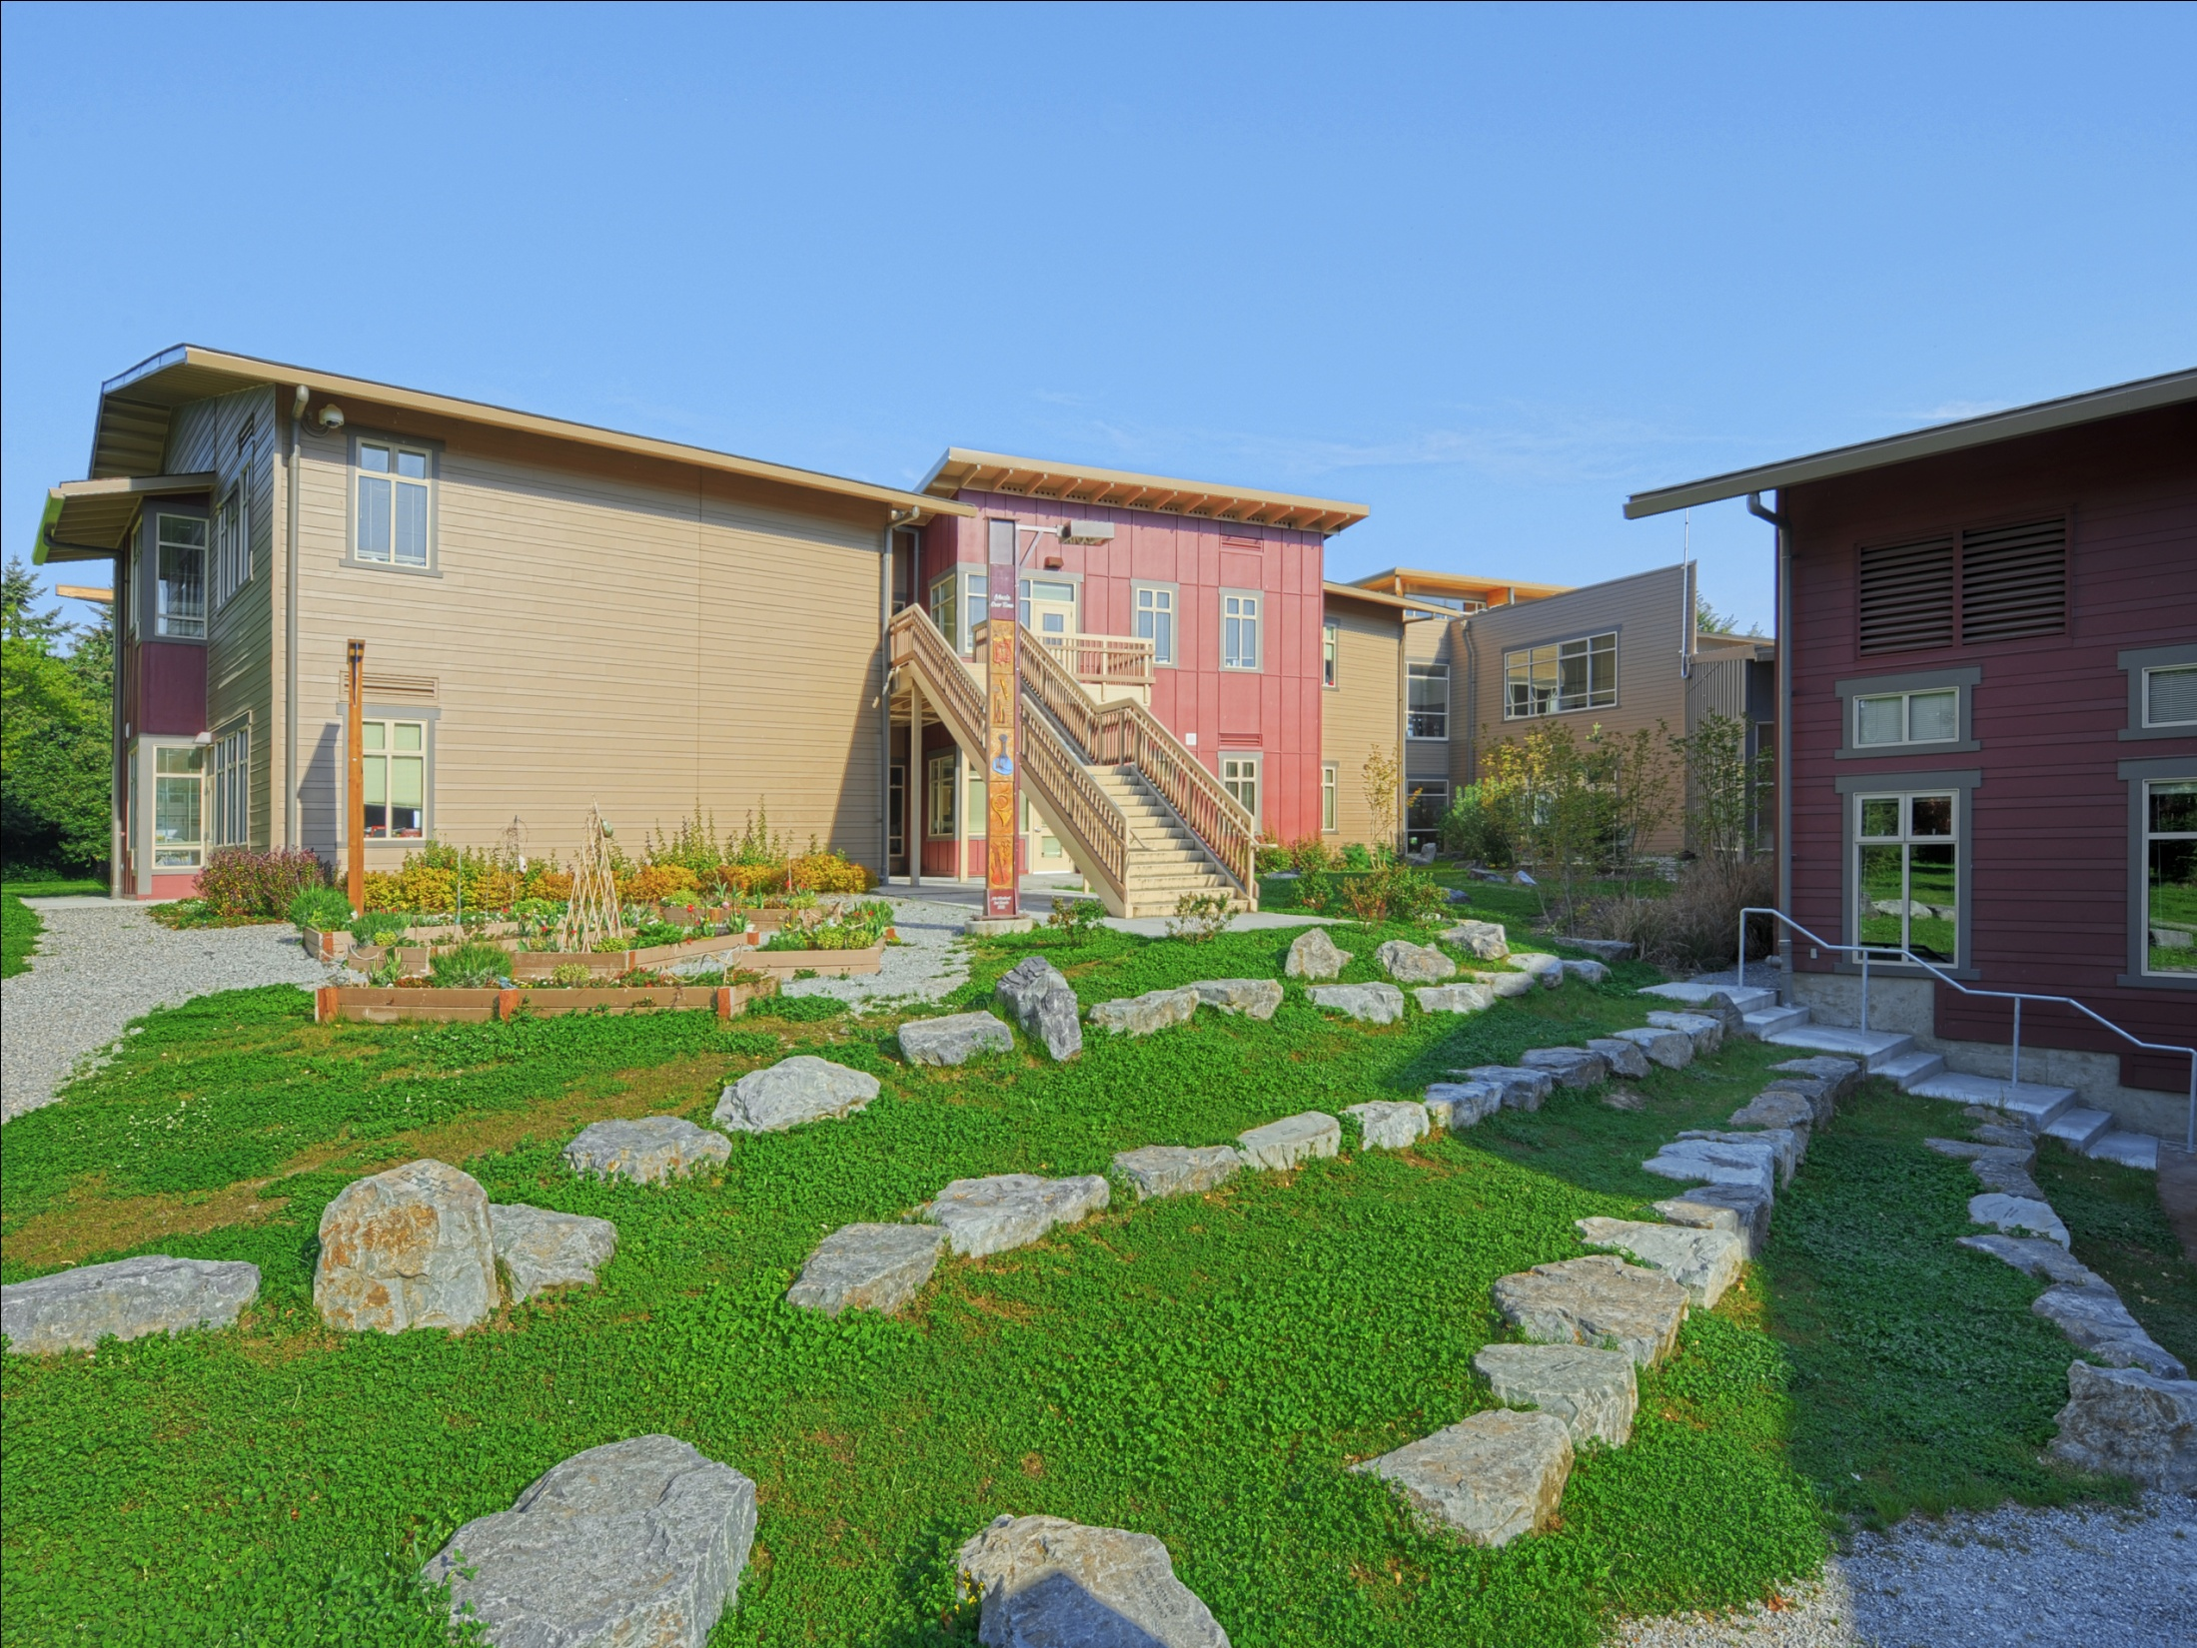

Slide 25
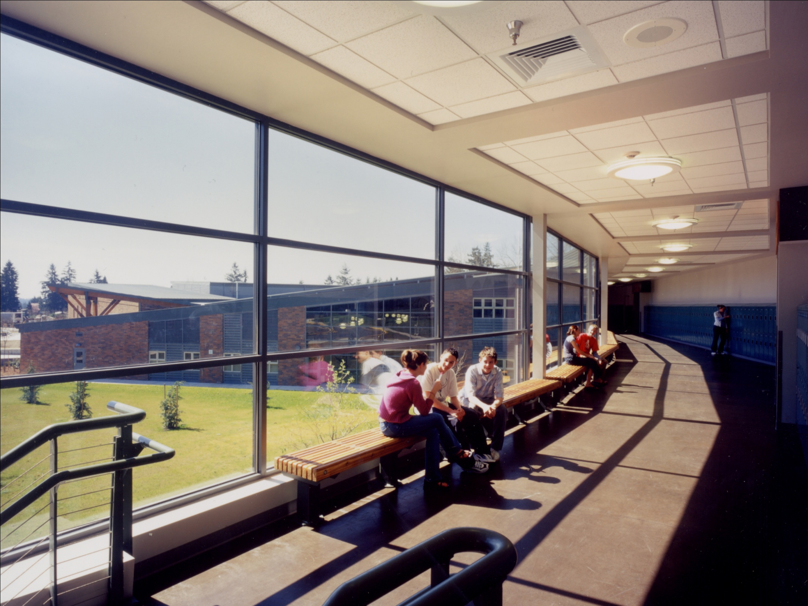

Slide 26
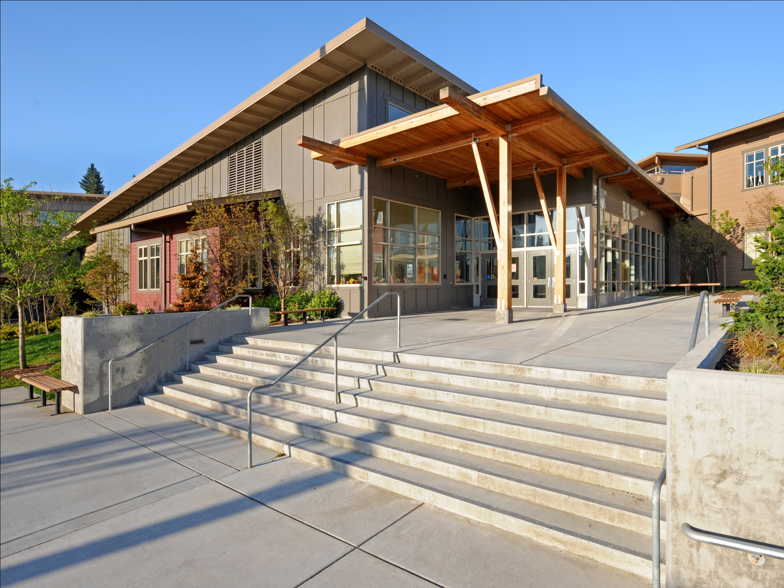

Slide 27
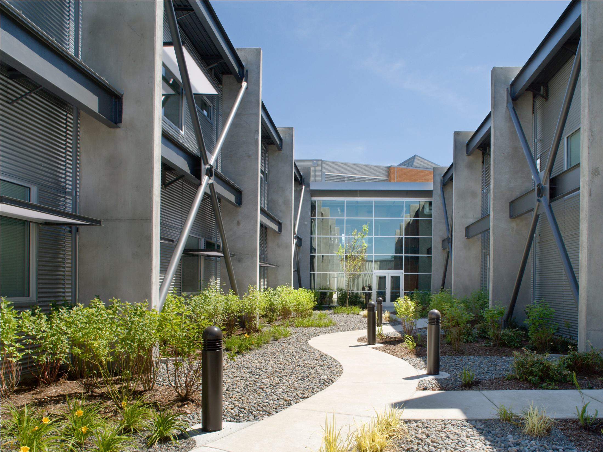

Slide 28
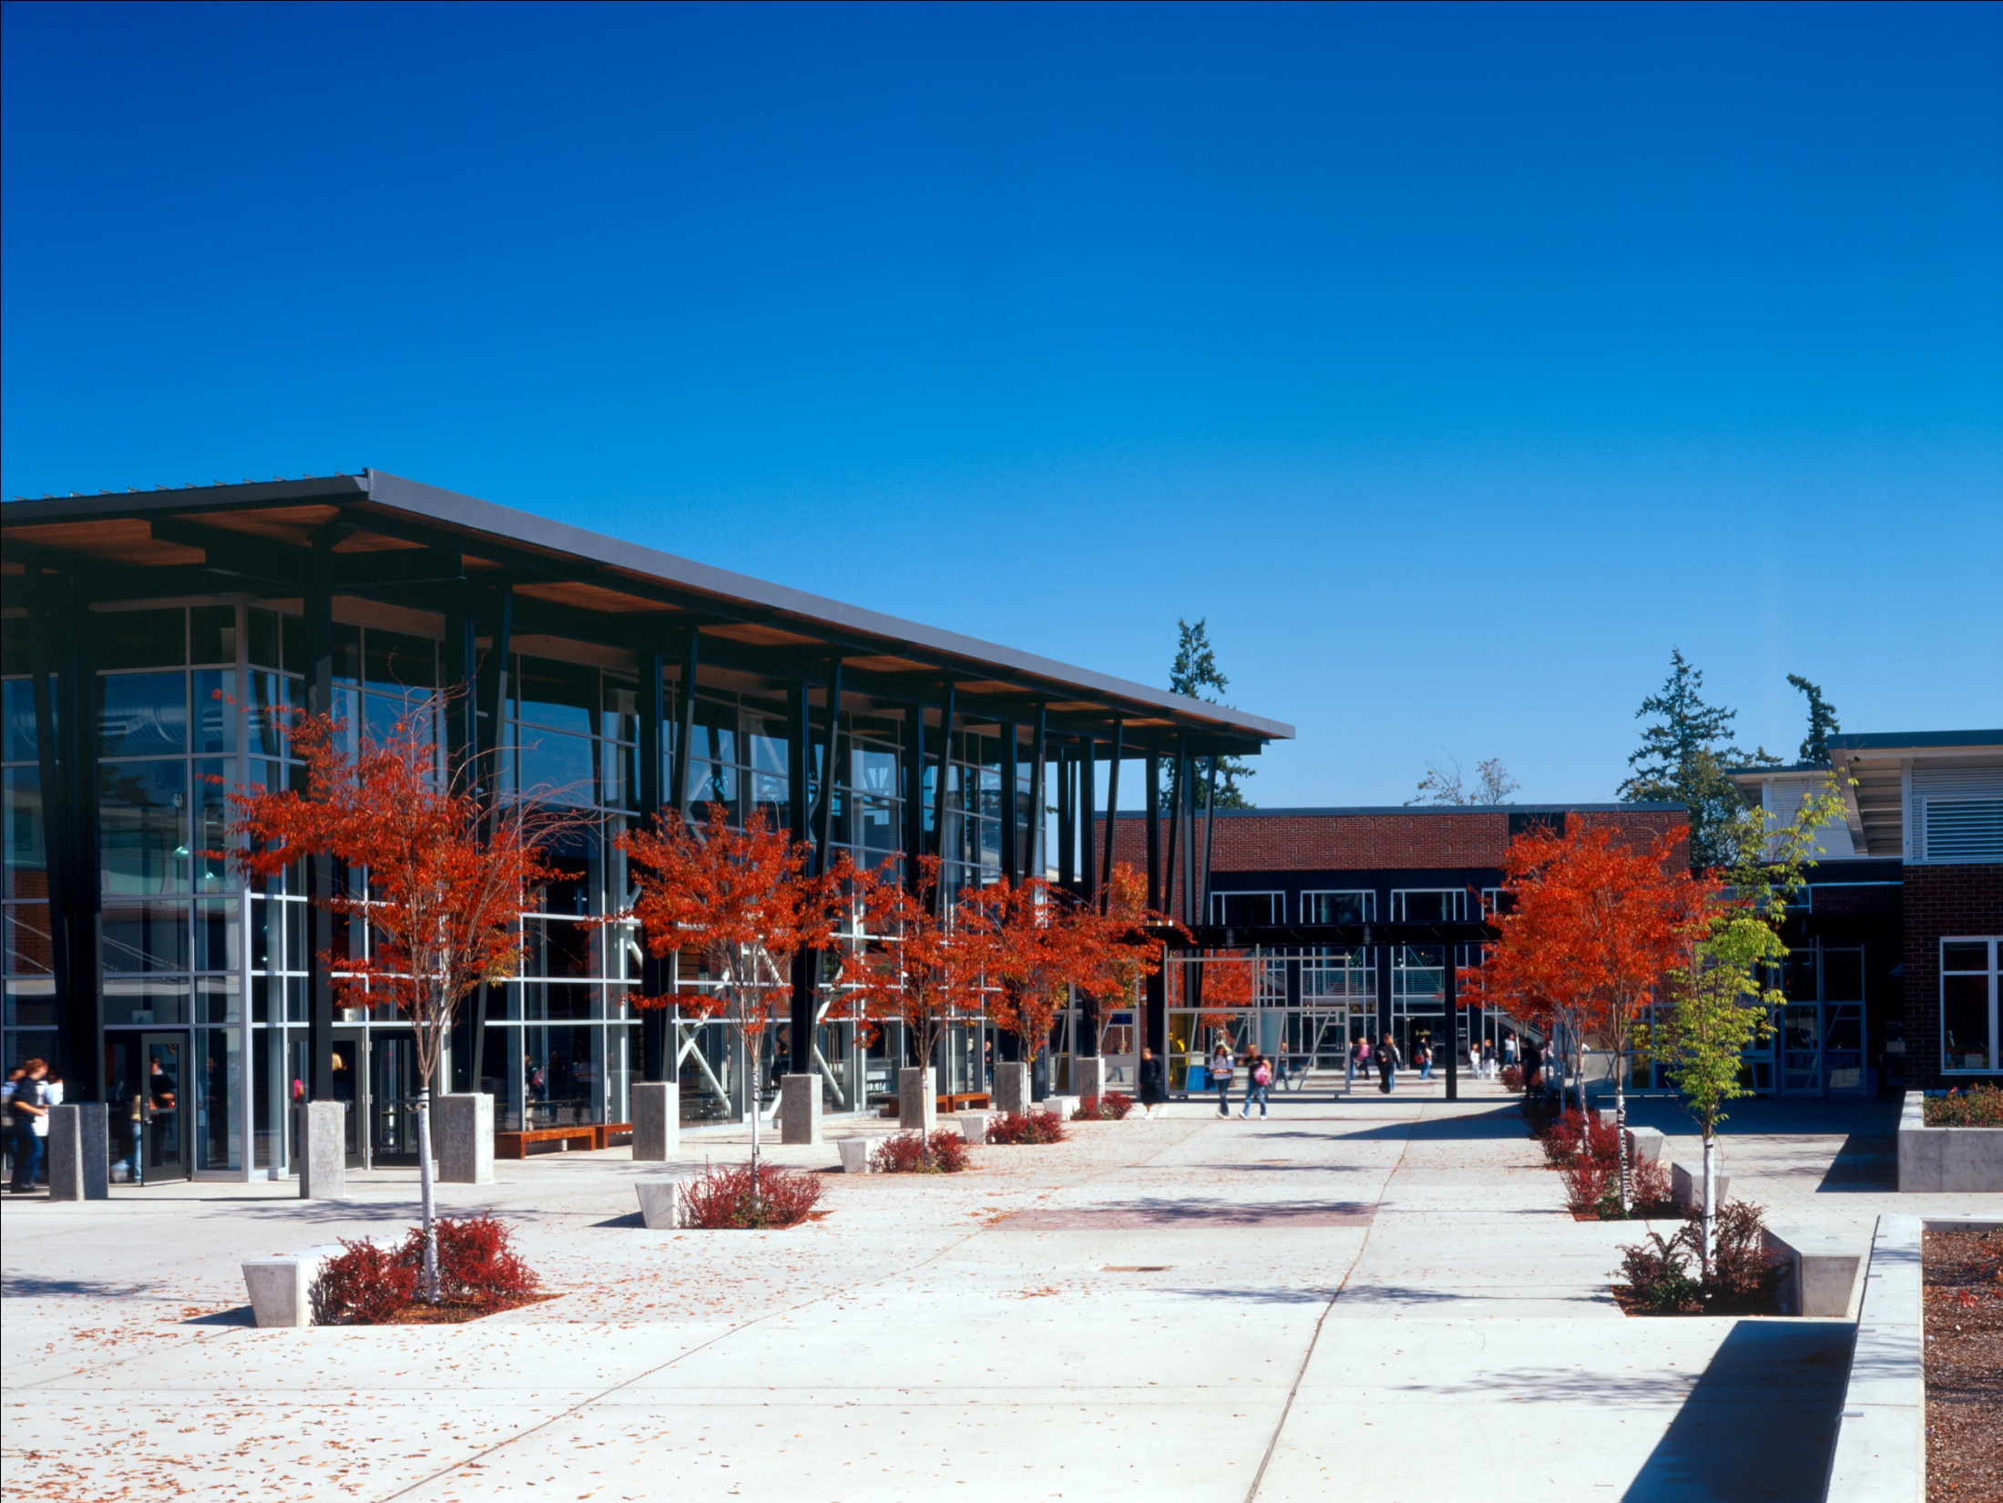

Slide 29
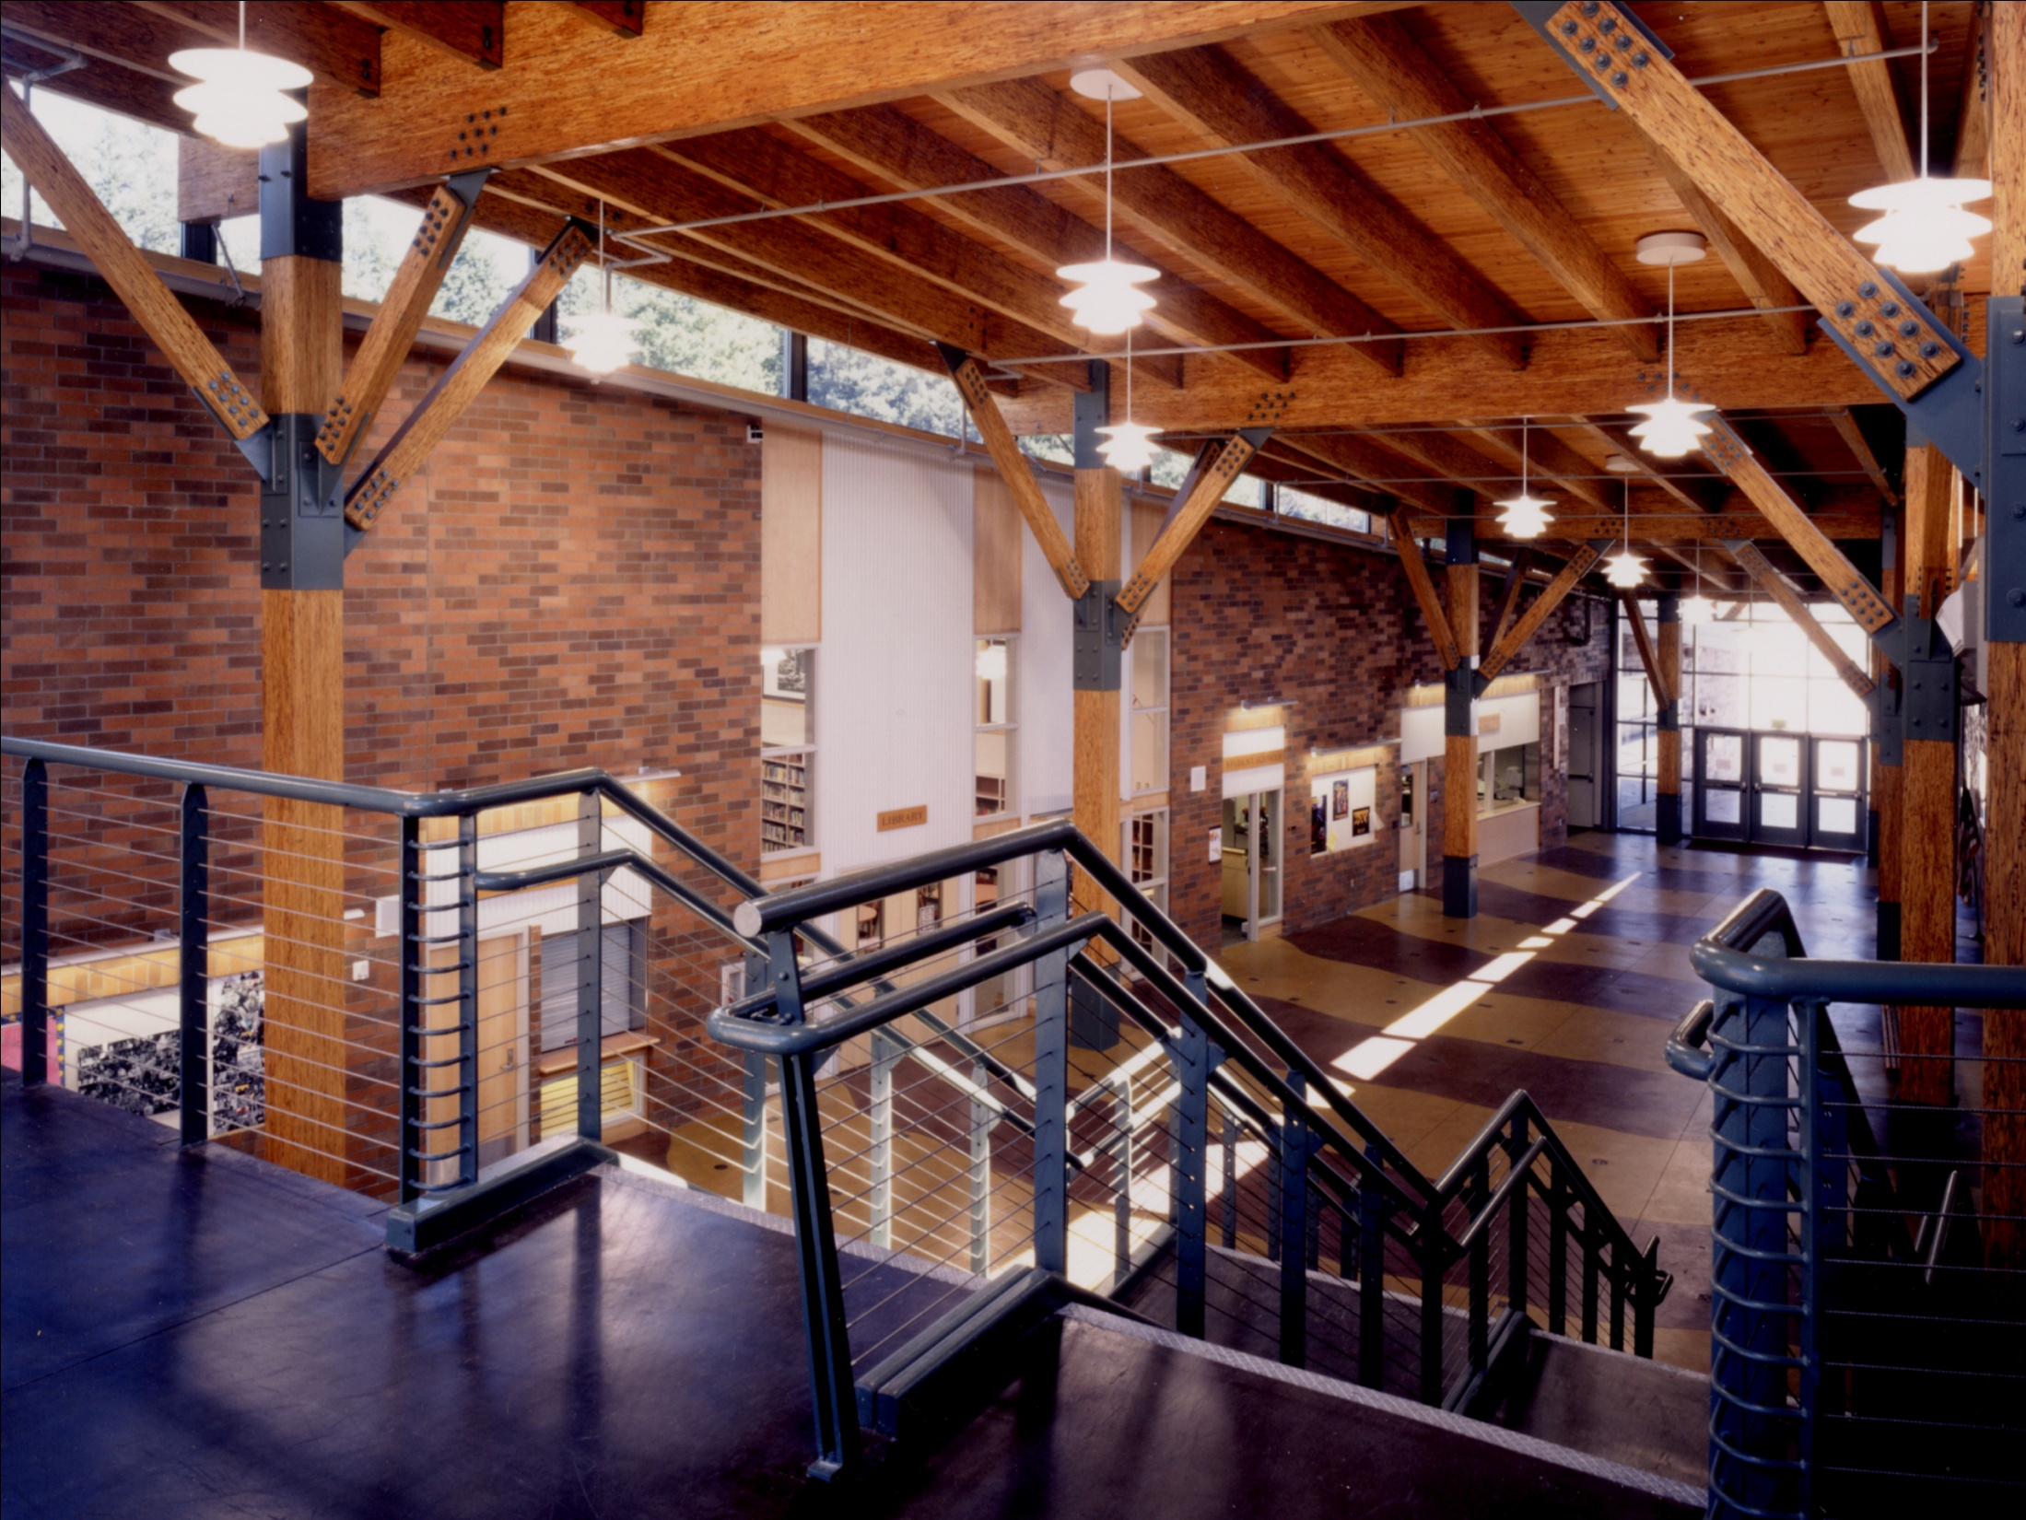

Slide 30
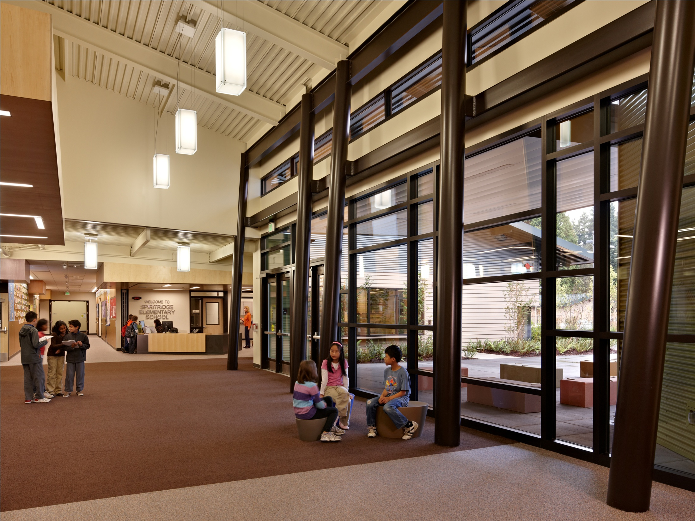

Slide 31
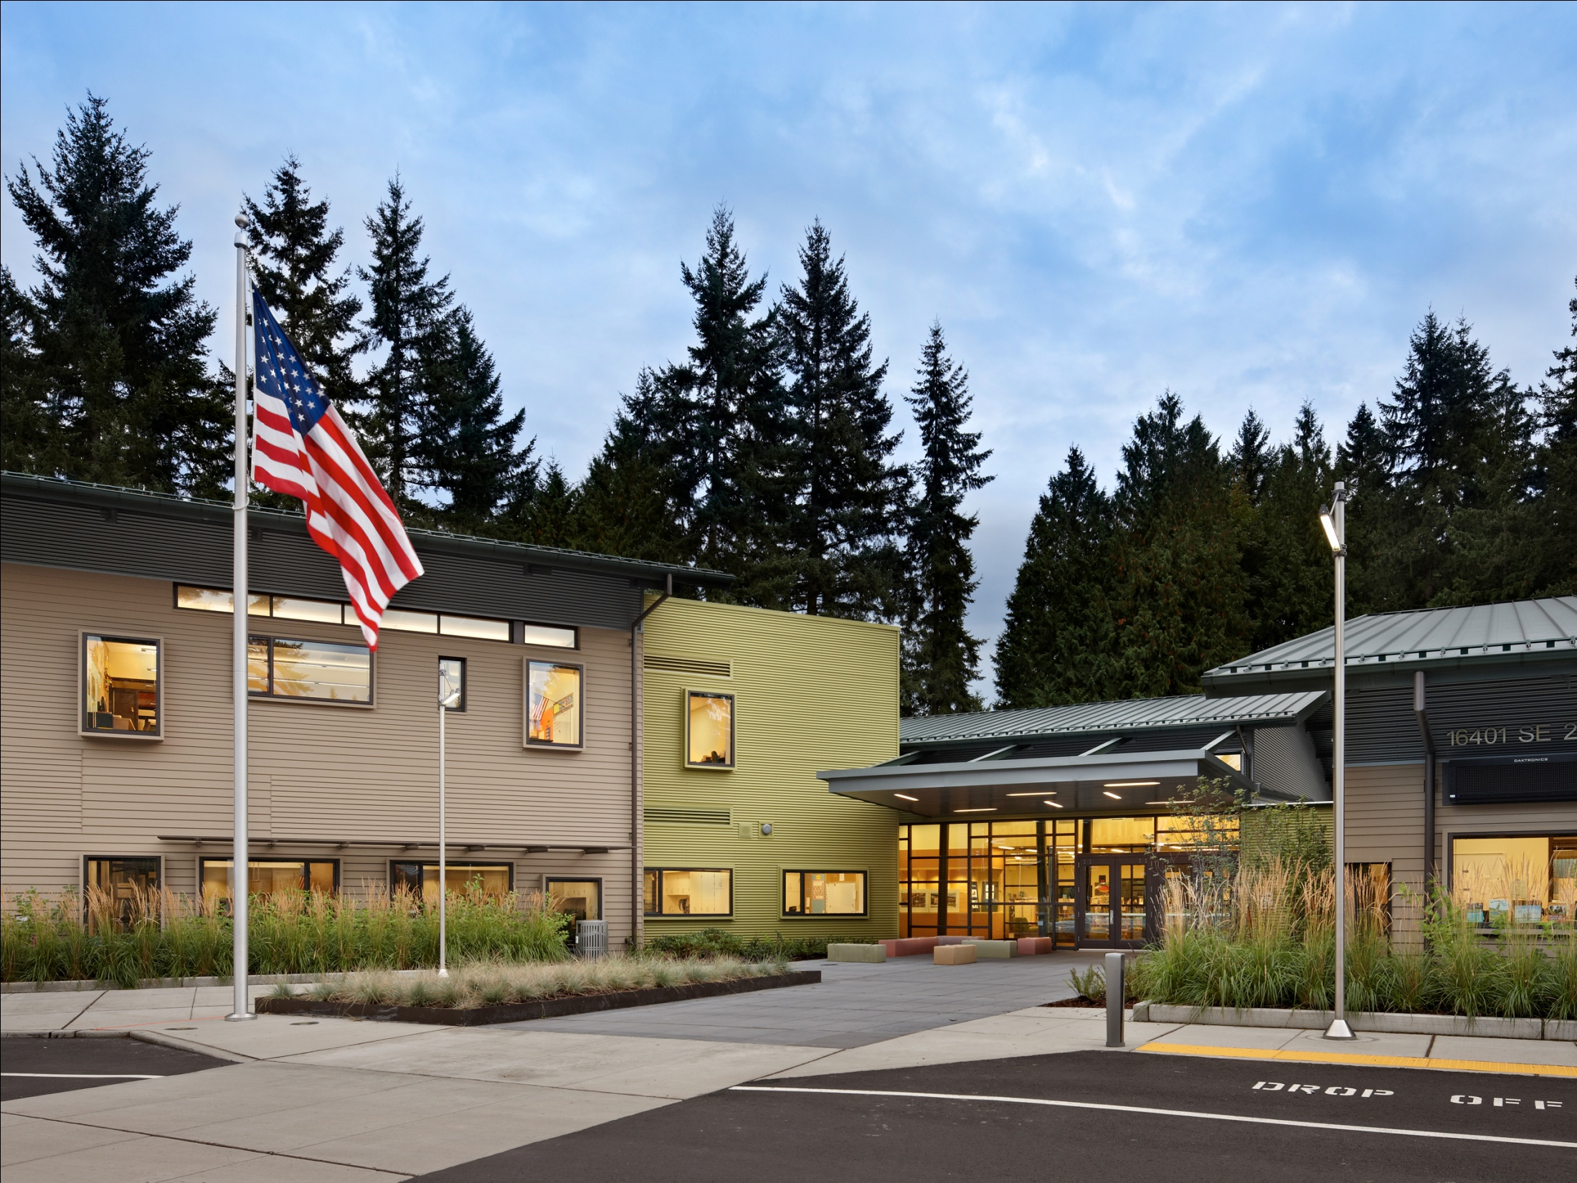

Slide 32
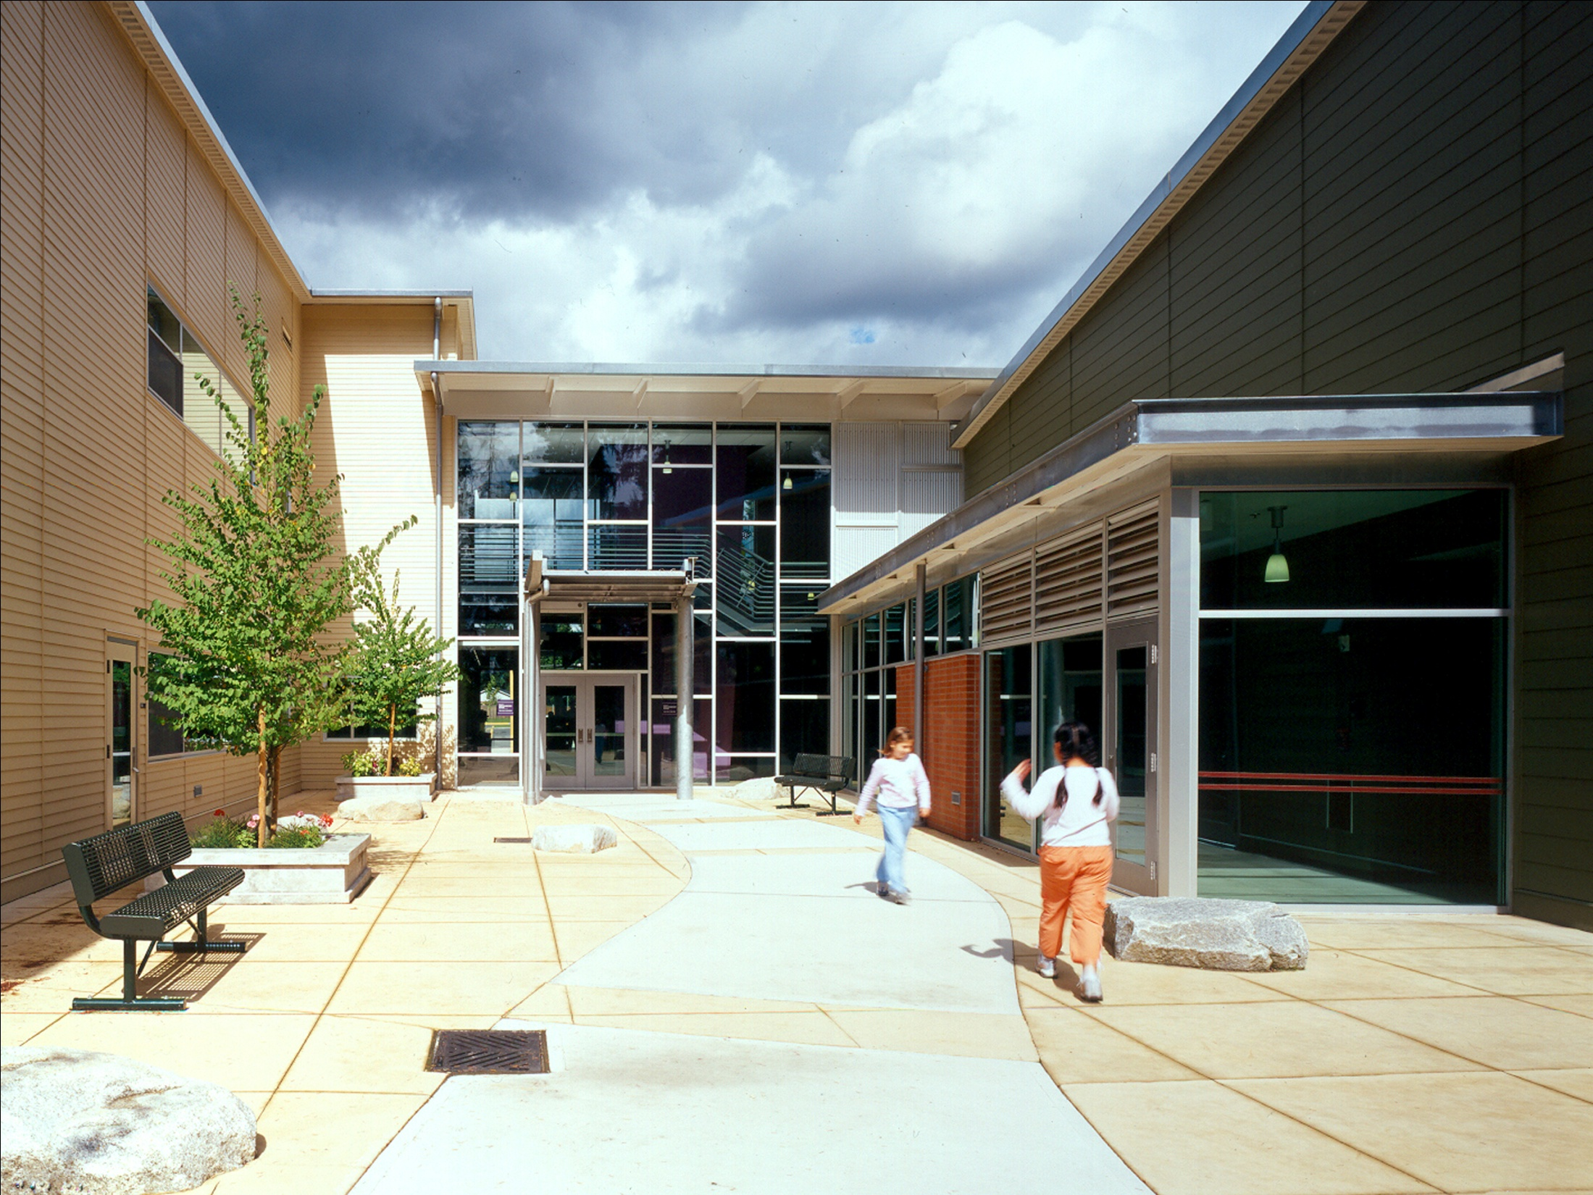

Slide 33
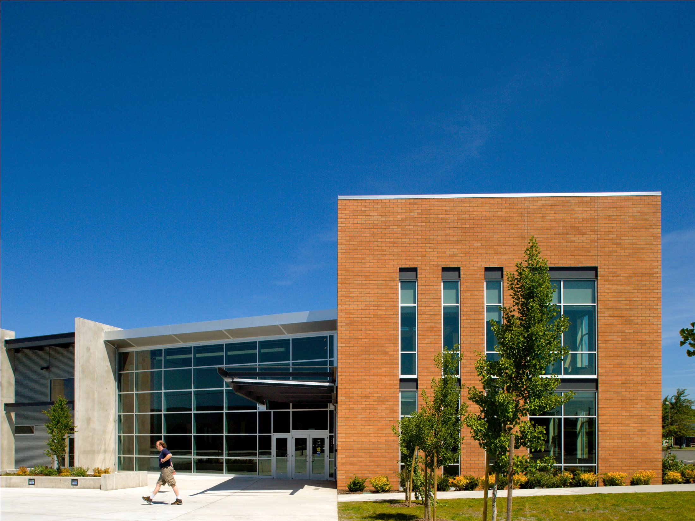

Slide 34
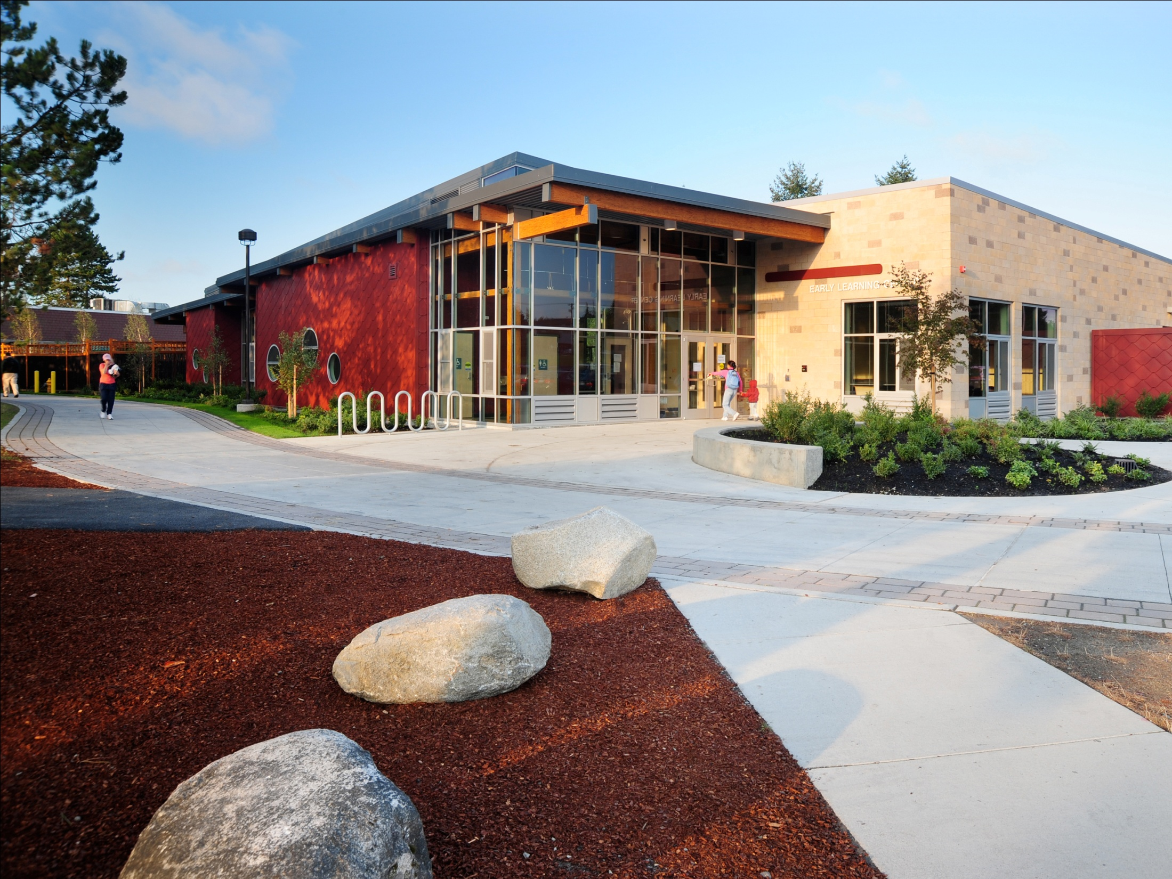

Slide 35
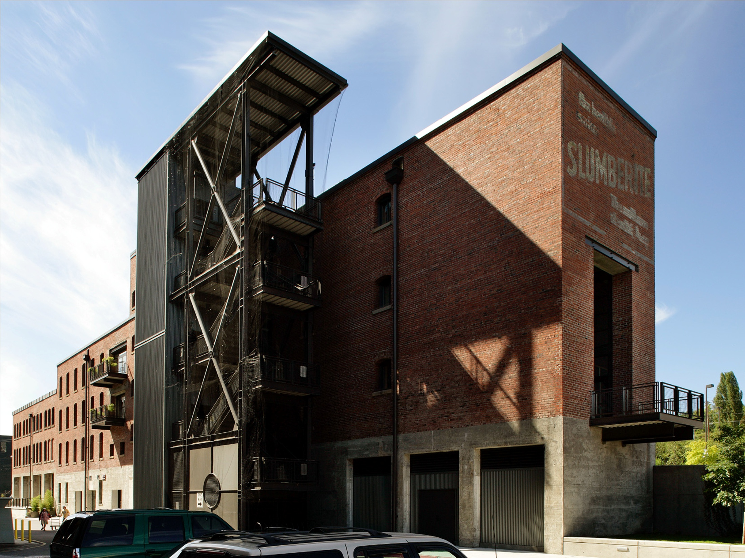

Slide 36
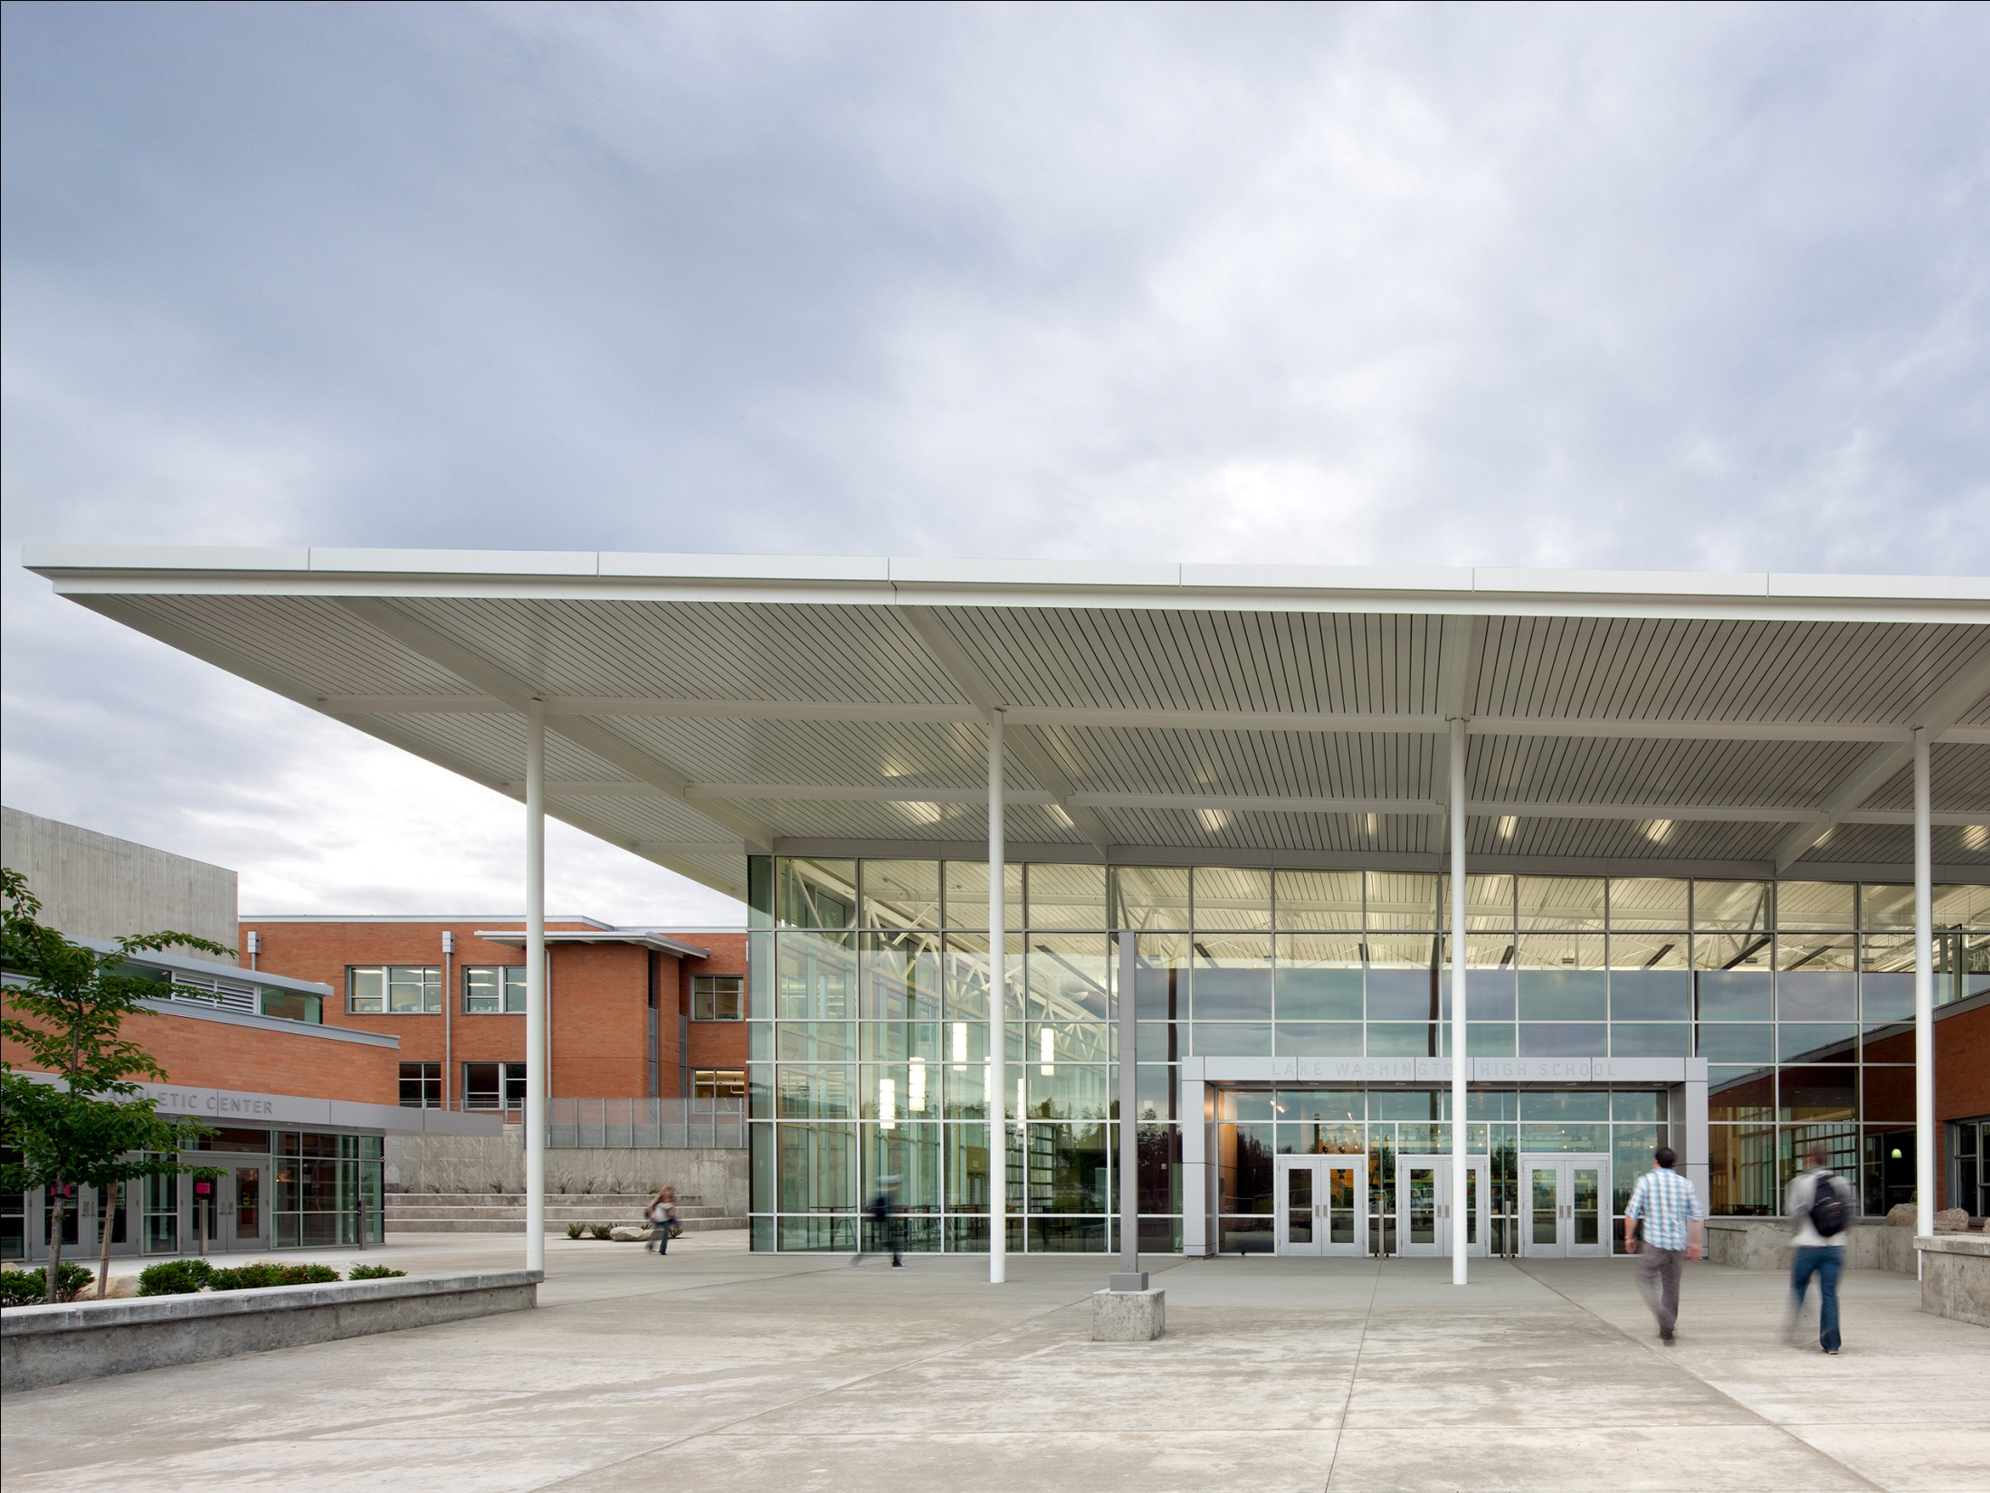

Slide 37
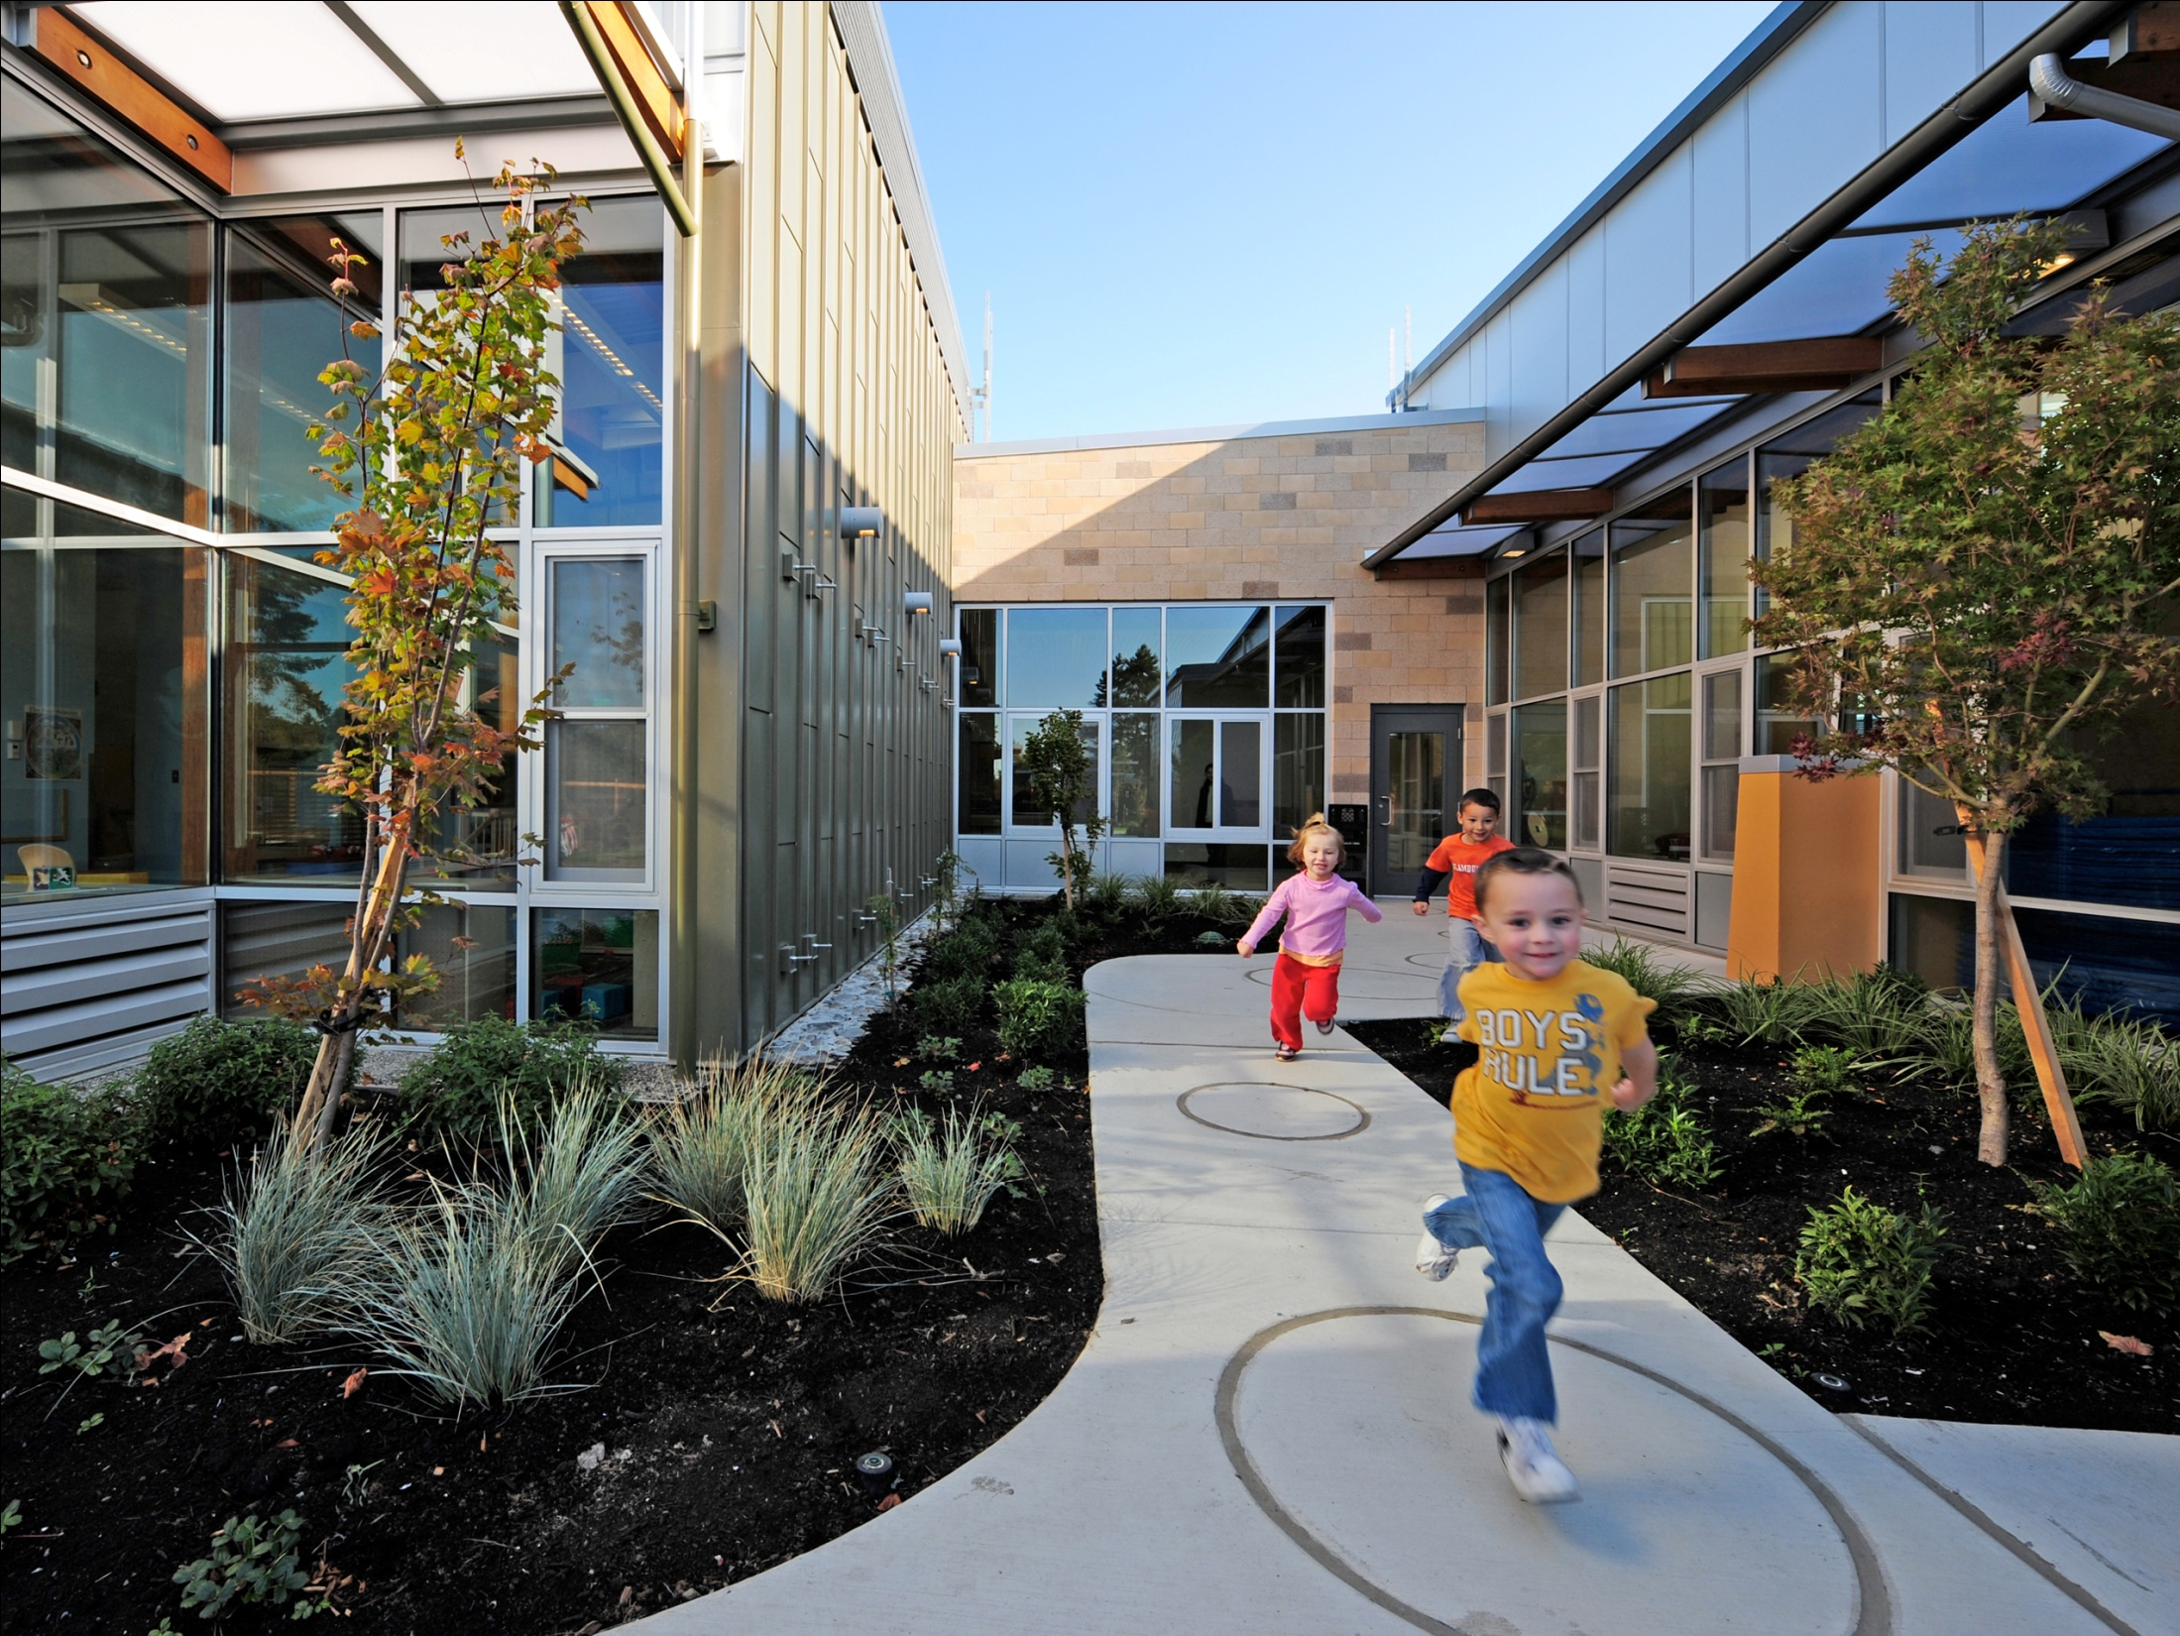

Slide 38
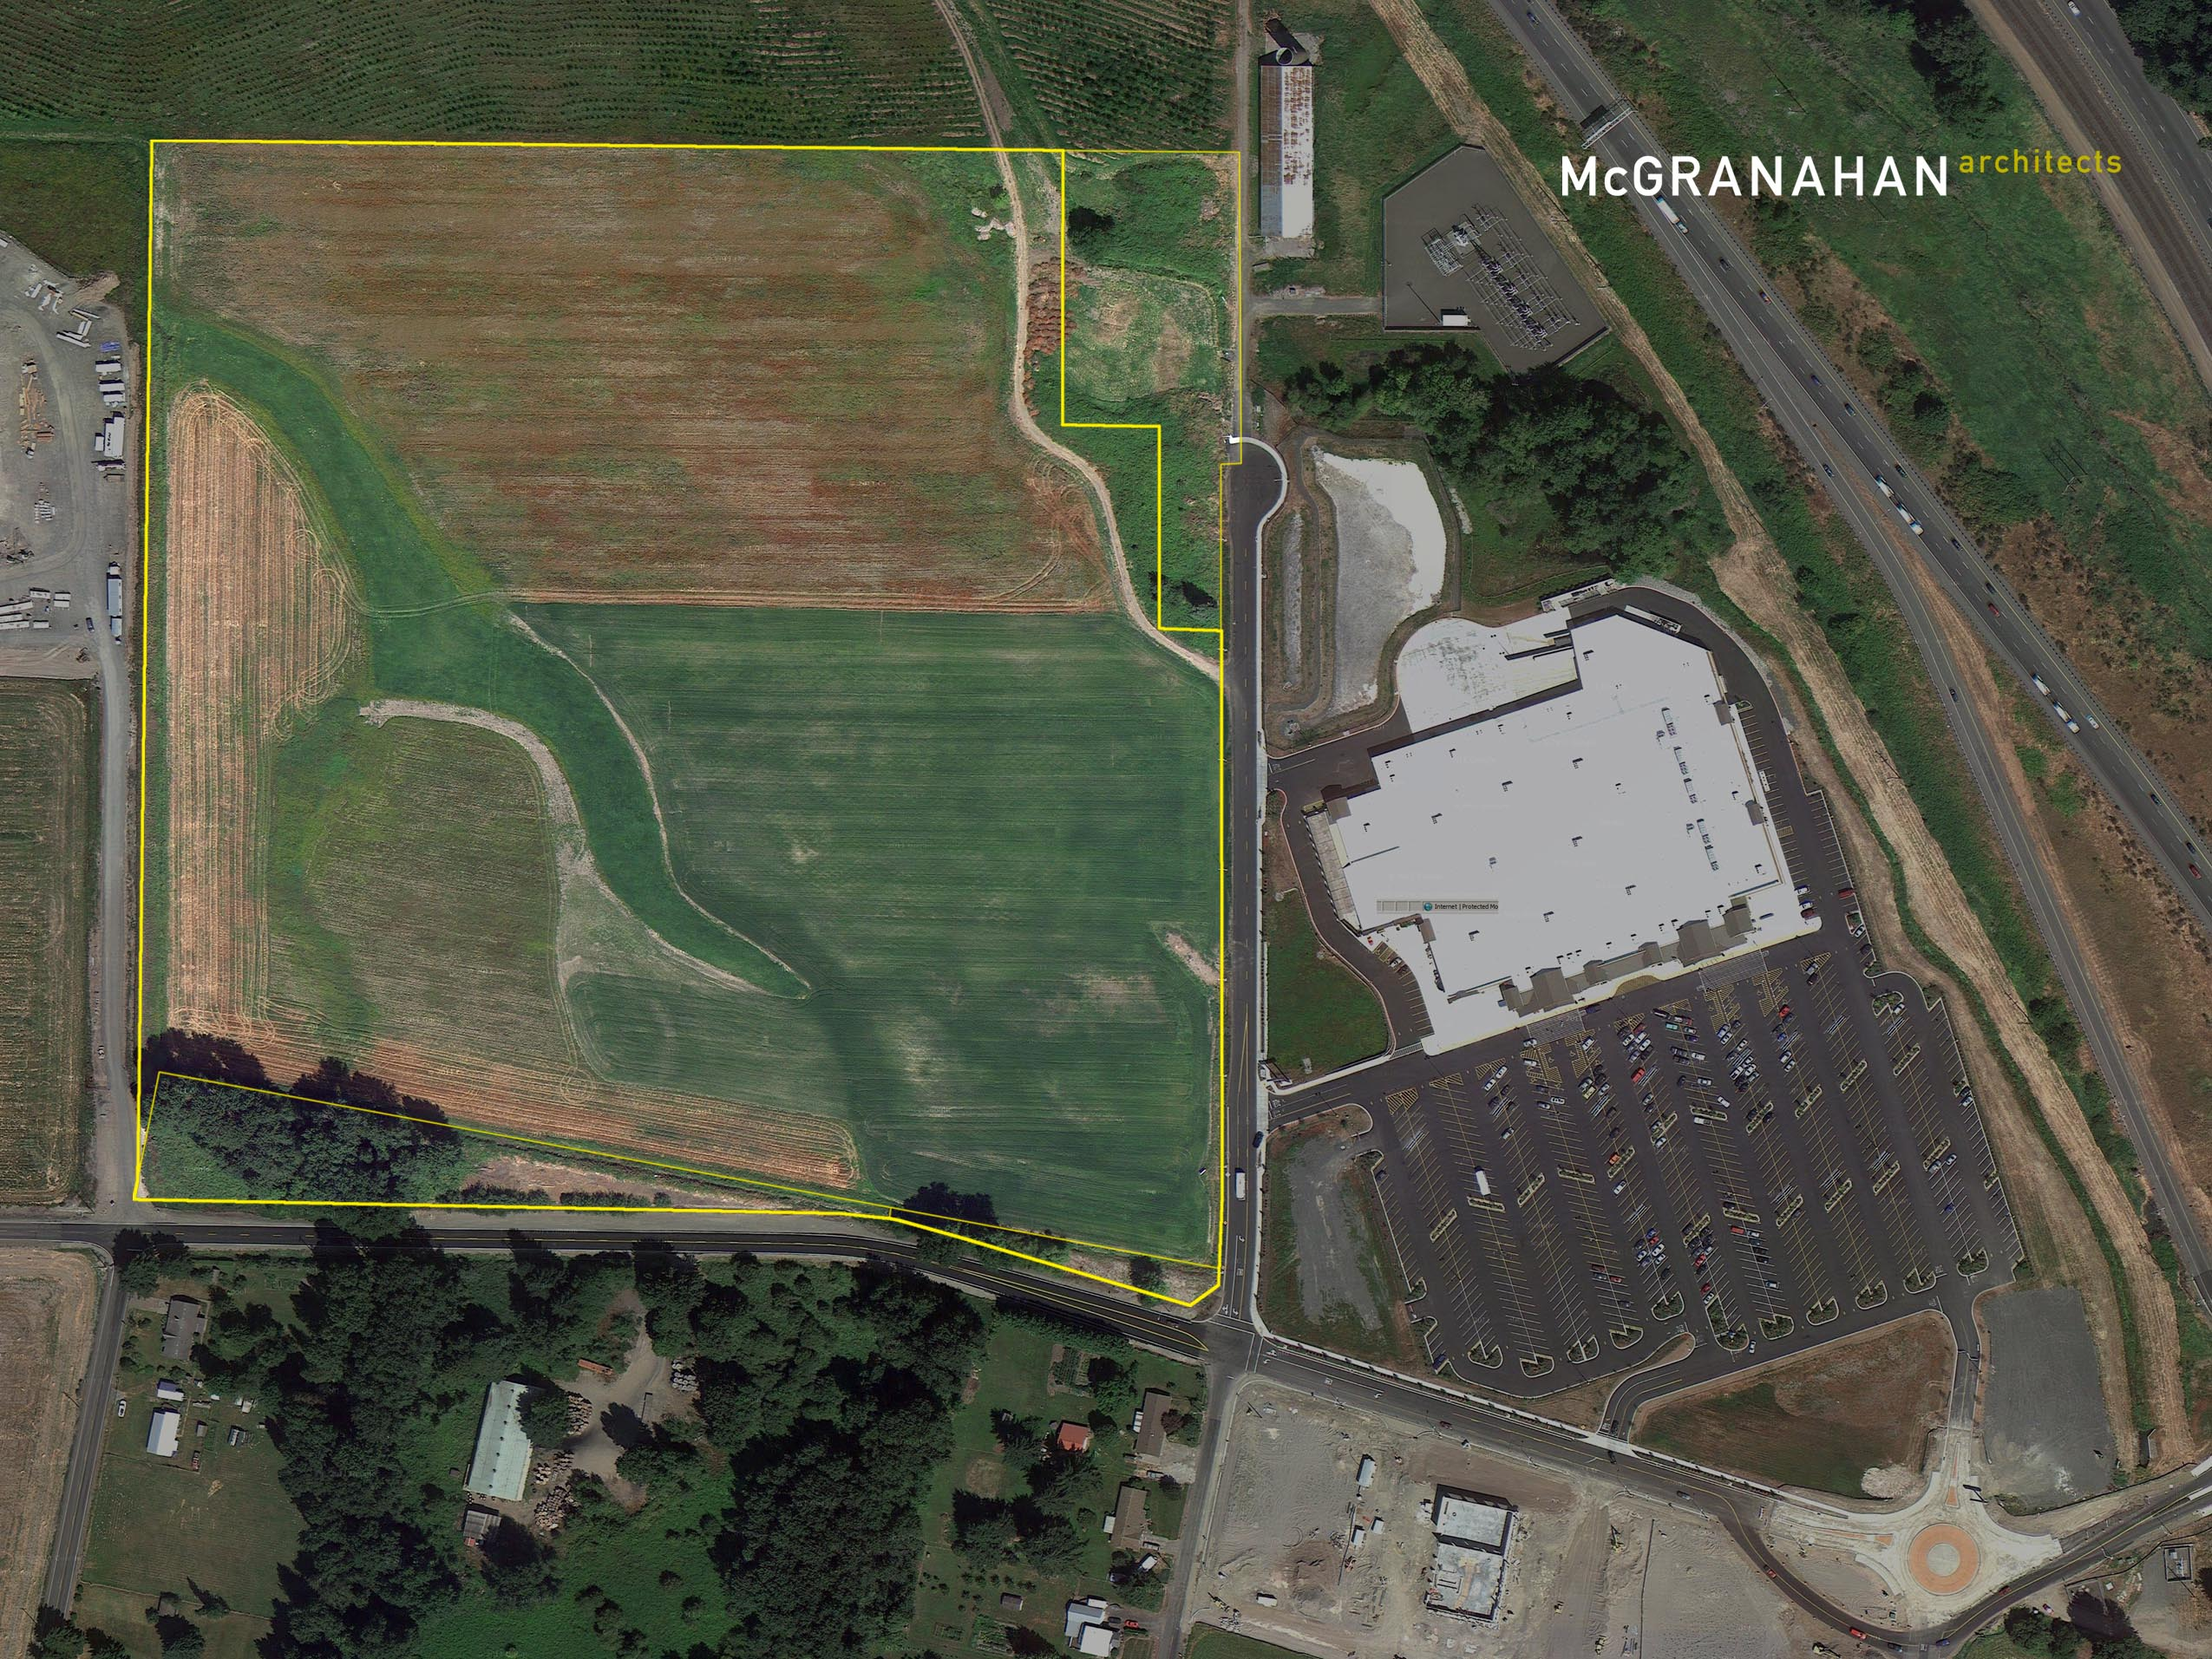
Rewarding results
Our benchmarks for success are in the fruits of a rewarding process; resulting in architecture that is remarkable to experience, brings transcendent value over time and fosters lasting professional friendships.

